Slide 1
Increase Value / Decrease Waste
Fundamentals of Continuous
Process Improvement
Molly Adzic
Wisconsin Human Services Financial Management Association 2021 Conference

Slide 2
Topics
What is Continuous Process Improvement
Identifying Waste
Tools for Improvement
Why is it Important
Defining Value

Slide 3
What is continuous improvement

Slide 4
Continuous Improvement
Team-based method focused on enabling and supporting employees in their efforts to streamline processes & optimize flow, by identifying & removing unnecessary, outdated or unproductive process steps
Systematic approach to identify and eliminate waste or non value add activity in your work processes
Set of tools and framework used to sustain an ongoing cycle of incremental positive change
Invitation to see your work in a new way
Techniques for seeing and solving problems more effectively by identifying and addressing the root cause of a problem
Even better
Even better
Better

Slide 5
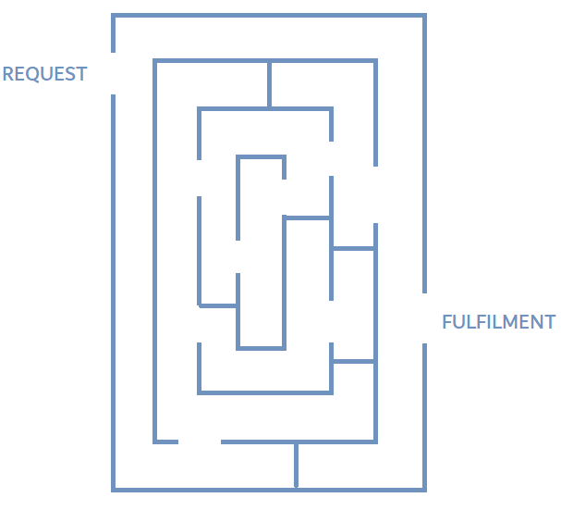
Think about it this way...
REQUEST
FULFILMENT

Slide 6
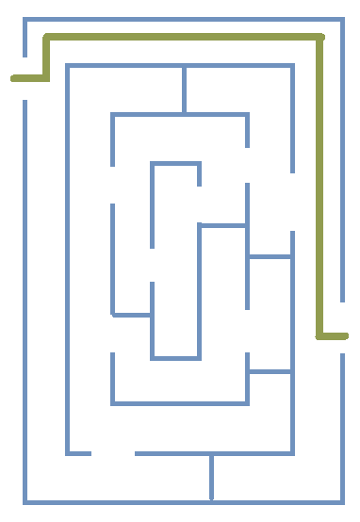
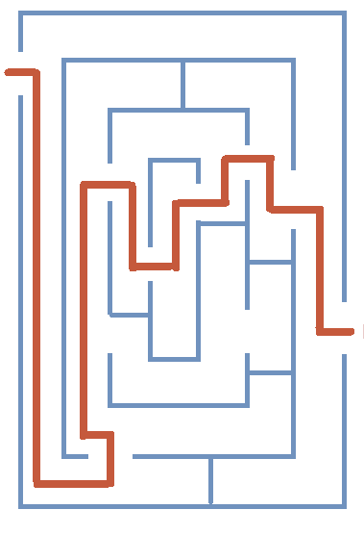
Which path would you choose?
A
B

Slide 7
What if you were looking at it from this perspective ?

Slide 8
These principles provide a framework and set of tools that help and invite you to see your work from a different perspective.
FULFILMENT
REQUEST
The birds eye view

Slide 9
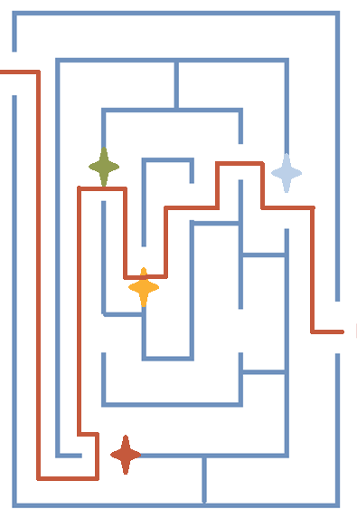
When you are able to see your work from a new perspective it helps you ask questions about the steps you are taking
I follow this path because:
REQUEST
The form I need is in another office
I have to wait for approval
I need to make a copy of this document
FULFILMENT
I need to get a special signature
Asking WHY is a really important tool

Slide 10
Why is it important
Goals and benefits of continuous improvement

Slide 11
Goals & Benefits of Continuous Improvement
Improve Efficiency & Effectiveness
Establish more efficient processes to deliver more and better services with the resources you already have
Reduce defects, errors, and variation in process or outcome
Increase capacity by fixing processes that waste valuable resources

Slide 12
Goals & Benefits of Continuous Improvement
Develop Effective People & Teams
Involving employees in the improvement process promotes active participation in change efforts, and builds an engaged & accountable team
Collaboration among employees stimulates a shared understanding of how each person is important to the organization’s success
Developing a sense of ownership and accountability for employees increases their effectiveness at delivering results

Slide 13
Optimal Performance
Quality Process
Engaged Employees

Slide 14
It is not about adding resources,
it is about doing more with what you have

Slide 15
Hard Dollar
Soft Dollar
Benefits
Service Level / Quality
Human Development

Slide 16
Identifying waste

Slide 17
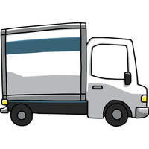
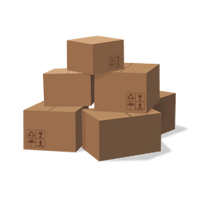
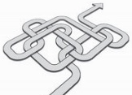
Forms of Waste
Defects
Overproduction
Waiting
Underutilized Talent
Transportation
Inventory
Motion
Excessive Processing
Efforts caused by rework, scrap, and incorrect information
Unnecessary movement of products and material
Production that is more than needed or before it is needed
Excess products and materials not being used
Wasted time waiting for the next step in a process
Unnecessary movement of people
Inefficiently using people’s talents, skills, & knowledge
More work or higher quality than is required by the customer

Slide 18
Why do we have Waste?
No Thanks
We’re too busy…
?

Slide 19
Busy = productive

Slide 20
ROLLING FIRST-TIME YIELD
Percent of occurrences where the entire process is completed without needing to be fixed or reworked in some way
This is the product of the Percent Complete and Accurate for each process step
Example: Processing Claims
1,000
Claims
Receive
Claim
Verify
Claim
Supervisor
Review
59% Claims Done Without Rework
Process
Close Case
90%
900 claims
90%
810 claims
90%
729 claims
90%
656 claims
90%
590 claims

Slide 21
Defining Value

Slide 22
DEFINING VALUE
Did I get what I wanted/needed, when I wanted/needed it
Did the product/service I received achieve desired results
How much effort (time/money) was required of me
Were expectations met
Timely
Easy
QUALITY
SAFE
Enjoyable

Slide 23
Tools for process improvement

Slide 24
Tools
Communication
Root Cause Analysis
Standard Work
Process Mapping

Slide 25
Communication
Be curious and ask questions

Slide 26
Process Mapping
Makes your process visible and understandable so you can more easily identify opportunities for improvement

Slide 27
The flow of events in a process
A process map identifies:
The order in which things occur
Inputs and outputs at each stage of a process
How each of the steps are interrelated
Who is responsible for & who the customer of each process step
How much time, energy, and effort goes into transforming our inputs into output

Slide 28
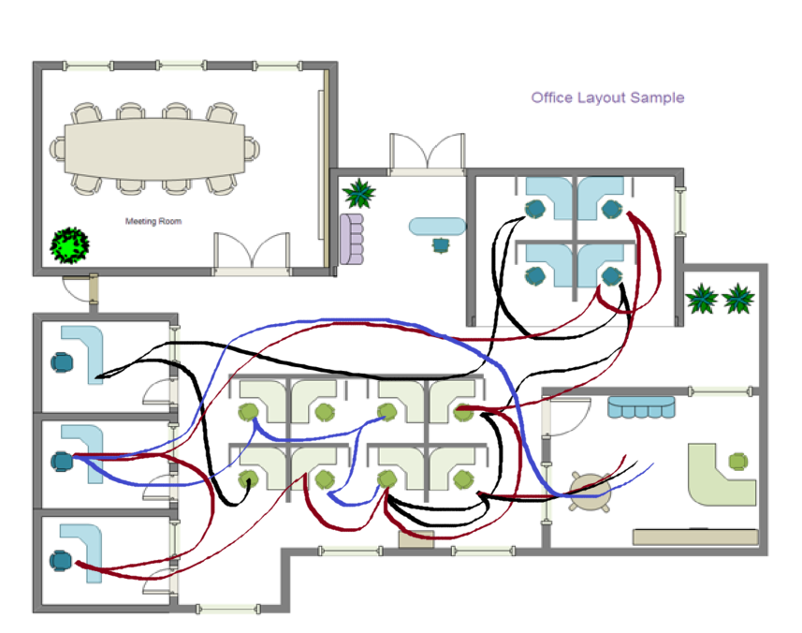
Spaghetti Diagram
A visual representation of process flow
A process is mapped using a continuous flow line to trace the path of work or materials through a process
The continuous flow line allows you to identify redundancies in the work flow and opportunities to expedite process flow

Slide 29
Traditional Mapping Symbols
Many types of symbols can be used in process mapping, but we will focus on three
Work steps are boxes containing a function that is performed
This
Action
Decision steps are diamonds that lead to two or more alternate paths. The wording should clearly express the key decision being made, with the alternate paths labeled accordingly
Action
Decision
Connectors are simply arrows that connect the various work steps and decision steps in the sequence performed.
Action
That

Slide 30
High Level Process Map
A small number of steps (<10) that describe the sequence of activities
There are typically no decision boxes in a high level map
Often an entire processes exist in one box of a high level process map
SCREEN
INTERVIEW
HIRE
ONBOARD

Slide 31
Process Mapping Swim Lanes
The Swim Lane process map show participants in different “lanes” instead of different colors
Allows you see what is happening at all points in time by each position
Helps you to understand others’ workload and how it might relate or overlap with your own
Helps illuminate workload imbalances
An unbalanced workload can cause overburden on employees, create delays, create artificial bottlenecks and resentment – WASTE
Helps to catch / identify
Waste and non value add activities
Redundancy in a process or duplication of efforts by individuals in different swim lanes
Notes:
What I want to spend the most time on is functional deployment

Slide 32
SCOPE
Start of process
TIME
End of process
Triggering Input
Final
Output
Department / Job Title / System

Slide 33
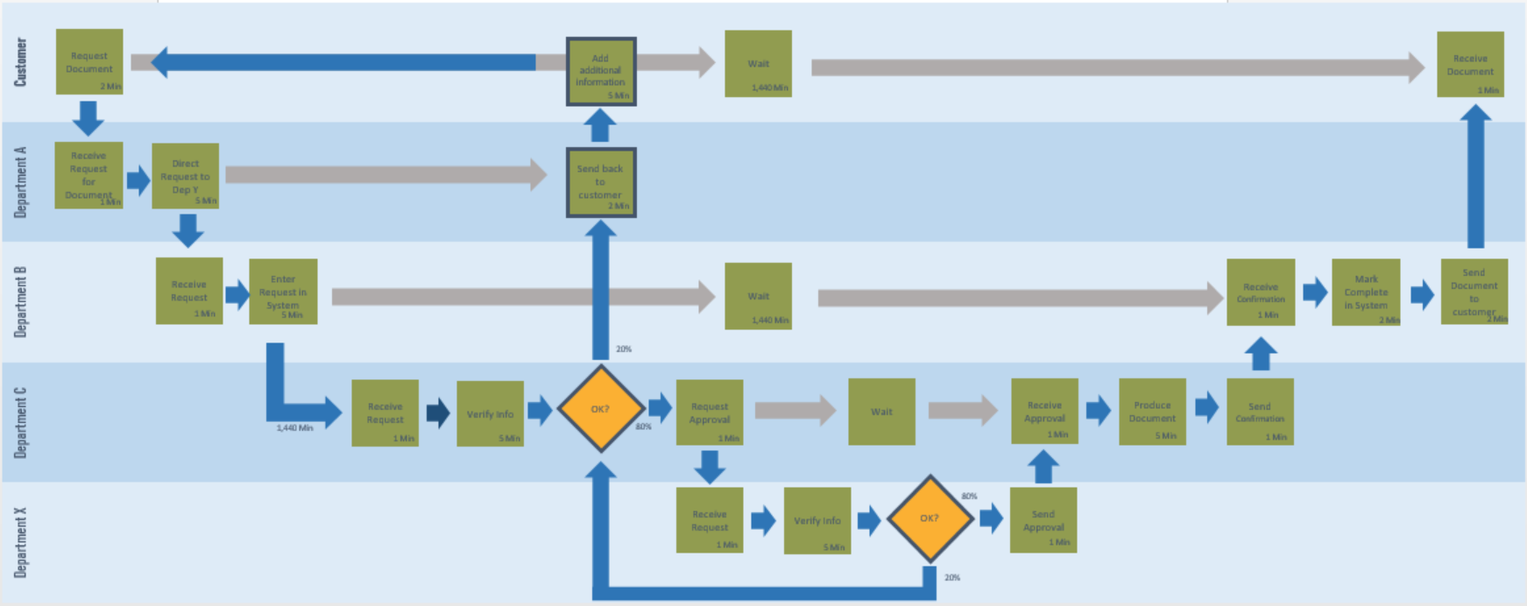

Slide 34
Process Mapping Loopbacks
Error correction loopbacks reduce the throughput & nearly always consume additional time and/or money.
Almost every loopback is an opportunity for process improvement, as they usually exist because of an unsolved problem
Why isn’t the work ready to move to the next step in the process?
Error Correction Loopback
YES
OK/ COMPLETE?
CHECK
FIX/ GATHER
NO
Can be designated by an extra bold boarder

Slide 35
Process Mapping Best Practices
Define the scope of the process, establish where the process starts and ends before getting started
Start with a “clean sheet” and map the process from scratch
If a documented procedure already exists, it must be set aside
Seek to identify what really happens – not what is supposed to happen
Not an exercise in fault finding or placing blame
No value is assigned to action steps when documenting a current state process
Document all steps of the process
Process mapping is best done with the help of the people who actually do the work
People not familiar with the process are also valuable in the process

Slide 36
Process Map Value Added Analysis
Once you have a detailed process map you separate value added steps from non-value added steps to determine where improvements can be made to reduce waste, increate value, and ultimately achieve a better flow.
Be on the look out for redundancies in communication, motion, and activity
Explore the outputs of each step - both positive and negative
Does this step increase or decrease the likelihood of an error or mistake
What does this activity contribute - is it necessary to achieve desired outcome?
Does the action have any undesired consequences?
Does this activity increase wait times or create bottlenecks
If the output of a step is valuable upstream, to whom? (now who the customer is & ask)
This must become a highly collaborative process and should be embraced as a learning opportunity
Ask questions, be curious, and seek to understand others’ perspectives
NOTE: There may be business required steps that do not add value for our customers

Slide 37
Root cause analysis

Slide 38
“If I had an hour to solve a problem I'd spend 55 minutes thinking about the problem and five minutes thinking about solutions.”
- Albert Einstein

Slide 39
5 whys
The internal mail is often late
“The delivery starts late”
“There is too much re-sorting”
“There is a significant number of wrong addresses”
“When people move we don’t update the address list”
Why?
Why?

Slide 40
Mess of Chemicals
“Secondary containers are overflowing”
“There are no empty containers available”
“They are full of chemicals waiting to be sorted”
“Only certain staff have been trained in segregating chemicals ”
Why

Slide 41
Check your Logic
Reverse the sequence and replace the word “WHY” with “THEREFORE”
“There is a mess of chemicals”
“Secondary containers are overflowing”
“There are no empty containers available”
“All containers are full of chemicals waiting to be sorted”
“Only certain staff have been trained in segregating chemicals ”
Therefore

Slide 42
Built in quality

Slide 43
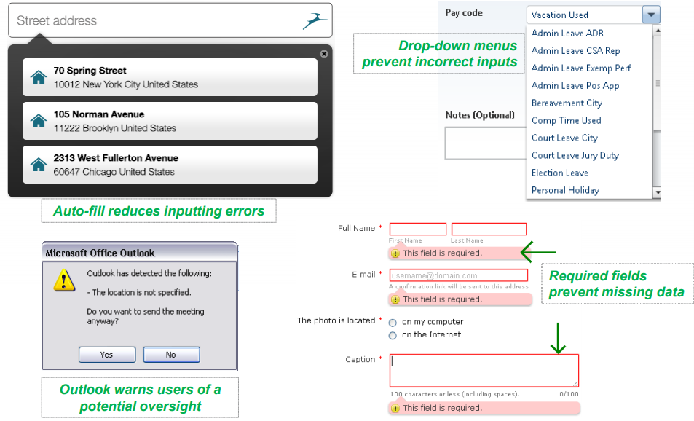
MISTAKE-PROOFING
Mistake proofing can prevent a mistake from being made or make mistakes easy to spot

Slide 44
Standard Work
Standardization means consistency and repeatability enabling you to maintain a specific result - Variation can easily lead to defects – WASTE
Consistency often leads to increase Quality / Productivity / Safety – VALUE
Helps manage and meet expectations by controlling output & processing time
Helps clarify what equipment, information, or materials are needed to complete a certain task
Creates alignment on what has already been done, what is currently being done, and what needs to be done at any point in a process
Helps to plan and organize work as a team – clear expectations and understanding of who is responsible for what, when.

Slide 45
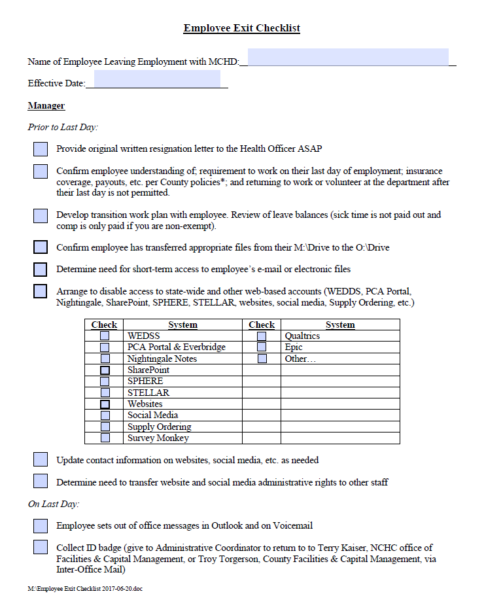
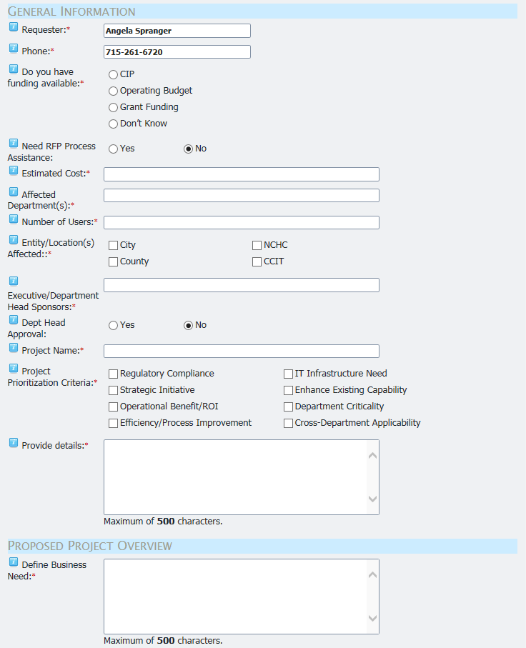
basic Example
Forms clearly identify what information is needed and often in which order
Reduces the need for back and forth, nothing gets lost in translation, and no need to rekey information

Slide 46
Conclusion

Slide 47
Objective
Identify and standardize the most efficient way to do a job that also maximizes safety, quality, and customer satisfaction at the lowest cost.

Slide 48
Improvements should be…
Staff driven
Customer focused
Sustainable
Small in scope to start
Within your control or influence
Things that
matter
What you should
focus on
Things you
can control

Slide 49
Questions?

Slide 50
Thank you!
Molly.Adzic@co.marathon.wi.us

