Slide 1
Children’s Long-Term Support (CLTS) Waiver Program

Slide 2
Overview
Program updates
Wait List Elimination Initiative
Statewide Rate-Setting Initiative

Slide 3
Wait List Elimination Initiative
Initiative began in October 2017
Wait List Elimination effort continues into 2019

Slide 4
Rate-Setting Agenda
Rate-setting initiative updates
Orientation to rate-setting materials
Transition to new rates
Next steps
Questions

Slide 5
Rate-Setting Initiative
The Wisconsin Department of Health Services (DHS) is implementing a uniform rate-setting methodology for most CLTS services to comply with federal Home and Community-Based Services waiver regulations.
This methodology will contribute to:
Statewide consistency.
Transparency in established rates.
Program standardization.
Service-specific outcomes.

Slide 6
Services Included in Rate-Setting
Adult family home
Case management
Child care
Community integration services
Counseling and therapeutic services
Daily living skills training
Day services
Most rates represent a ratio of
one direct caregiver to one CLTS participant.

Slide 7
Services Included in Rate-Setting, continued
Financial management services
Mentoring
Nursing services
Respite
Supported employment
Supportive home care
Transportation
Most rates represent a ratio of
one direct caregiver to one CLTS participant.

Slide 8
Services Exempt From Rate-Setting
Adaptive aids
Children’s foster care*
Communication aids
Consumer education and training
Home modifications
Housing counseling
Personal emergency response systems
Relocation services
Specialized medical and therapeutic supplies
Training for unpaid caregivers
*DHS will continue to set children’s foster care rates in coordination with the Department of Children and Families.

Slide 9
Rate Methodology: Alignment
Rate methodology aligns with existing rates for comparable services:
Medicaid fee-for-services (therapies, transportation, nursing, personal care)
Family Care and IRIS (adult family homes, financial management services)

Slide 10
Rate Methodology: Alignment, continued
Department of Children and Families (child care, foster care, institutional respite rates)
Department of Workforce Development, Division of Vocational Rehabilitation (employment support service fee structure)

Slide 11
Rate Methodology Components
Provider type
Direct caregiver costs
Care level
Outliers

Slide 12
Rate Methodology: Provider Type
Types: Agency or Individual
Provider agency rates include higher administrative percentage due to increased employer roles and responsibilities, such as:
Recruitment
Training
Supervision
Issuing wages
State and federal reporting requirements

Slide 13
Rate Methodology: Direct Caregiver Costs
Most service rates include direct caregiver costs:
Wages
Withholdings (examples: federal and state taxes, benefits)
Exception: Financial Management Services (FMS)
FMS rates only include administrative costs of processing service provider payments and related activities.
Flat, per participant per month (PPPM) rates

Slide 14
Rate Methodology: Care Level
The child’s care level based on CLTS functional screen data and other information
Services: supportive home care and respite
Levels: low, medium, high

Slide 15
Rate Methodology: Outliers
Exceptions to the CLTS rate schedule based on:
Participant’s individual care needs
Service availability

Slide 16
Rate Methodology: Day & Group Rates
Day rate methodology:
Respite
Group rate methodology:
Daily Living Skills Training
Mentoring
Supportive Home Care
Respite

Slide 17
Rate Implementation
The rates represent the maximum amounts that can be paid for each service unit without an outlier rate (outlier rates can be considered in individual circumstances).
County waiver agencies (CWAs) are prohibited from negotiating rates with providers for in-scope services.

Slide 18
Rate Implementation, continued
Services may be paid at rates lower than DHS-based rates in circumstances where the actual service cost (usual and customary) is lower than the DHS-based rate for a particular service.

Slide 19
CLTS Provider Agreement Forms
To align with rate-setting initiative, updated January 2019 agreement forms require providers to accept the DHS established rates.
Providers must complete, sign, scan, and upload updated agreement forms during registration process.

Slide 20
CLTS Provider Agreement Forms, continued
All providers re-register every four years.
DHS issues a reminder message before the four-year re-registration deadline.
CWAs will be able to access signed agreements from registry (provider only completes form once).

Slide 21
Rate Schedule Updates
Follow-up to public comments
Clarifications
Adjustments
CLTS Waiver Program Rate Schedule, P-02184

Slide 22
CLTS Benefit Code Crosswalk Updates
CLTS Code Crosswalk, P-02283

Slide 23
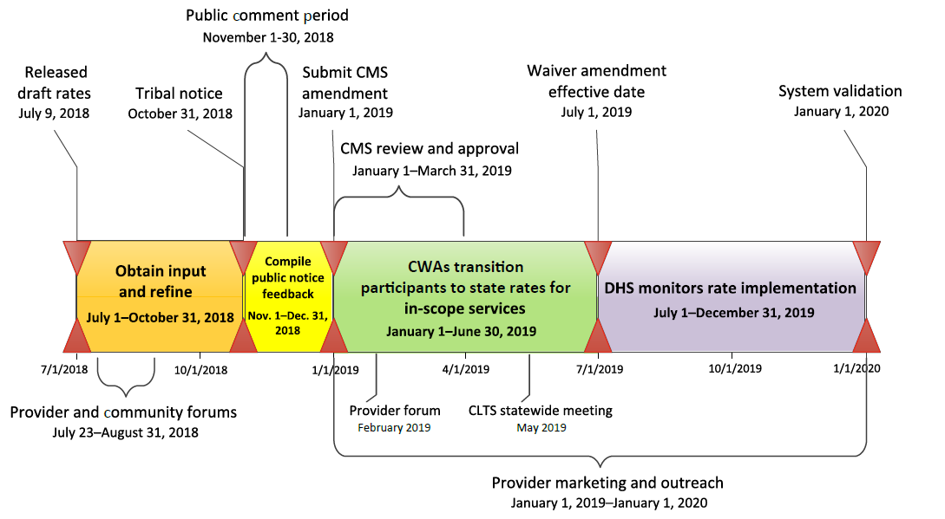
Transition to New Rates

Slide 24
Questions?

Slide 25
Resource and Contact Information
Website
CLTS Rate-Setting Initiative
Contact information for CWAs
Code crosswalk, authorization questions, email DHS Provider Registry Other questions, call CLTS technical assistance leads Sign up to receive updates for CLTS rate-setting initiative only
Contact information for providers
Registry, directory questions, email DHS Provider Registry Sign up to receive updates for CLTS Waiver Program

