Slide 1
WHSFMA Conference
May 11, 2018
Notes:
Sign in Sheet

Slide 2
Agenda
VPN Replacement
Trust Accounts
Overpayments
In Process Checks
Resources
Questions
^{dcf.wisconsin.gov}
Notes:
Welcome
Introduction
Reminder to sign in

Slide 3
VPN Replacement
VPN – Virtual Private Network
Enables users to send and receive data across networks
Financial
REPL
eWiSACWIS
eWiSACWIS
County
County
^{dcf.wisconsin.gov}
Notes:
Financial interface
Two-way interface/file exchange between eWiSACWIS and the County
eWiSACWIS sends provider and payment information to the County.
The County sends back check numbers and dates to eWiSACWIS.
REPL = replication database
One-way transfer from eWiSACWIS to the County. A subset of the production eWiSACWIS tables are replicated to the county locations for reporting and financial interface processing on a nightly basis.
Only about 10-15 counties use REPL

Slide 4
VPN Replacement
FTP – File Transfer Protocol
Still enables users to send and receive data across networks, just in a different way
Improved security, cost savings, less maintenance, industry standard
Counties will be required to make the switch from VPN to FTP
Email communication forthcoming
Proposed schedule
Technical details
Instructions
^{dcf.wisconsin.gov}
Notes:
Retiring VPN and moving to FTP
Ask if anyone is interested in going first - indicate on sign-in sheet or come talk to me after

Slide 5
Trust Accounts
County’s Cost of Care
Refunds
Amount used in Title IV-E claiming calculations
Used to document money collected by counties that is applied to the cost of care for a child before claiming federal Title IV-E money
Separate from your county’s accounting system
Automatically created when a child first enters a claimable placement
Remains in eWiSACWIS regardless of the child’s placement status
^{dcf.wisconsin.gov}
Notes:
The Trust Account Module was developed to track county costs of care and the refunds (Child Support, SSI, SSA, Waiver contributions, etc.) that come into the county to offset those costs. The net result of the costs of care less the refunds determines the amount that the county uses in their claiming calculations to the Federal Government. Trust Account information is child and county specific. When you view a child's Trust Account, you will be looking at all of a county's costs of care for that child across all cases.
We know you have a bank account in your county where you’re keeping the trust account money and you probably have a ledger in a different system where you’re keeping track of that money, but you also have to keep track of it within eWiSACWIS. If you’re not currently documenting trust account deposits in eWiSACWIS, you need to start documenting them so that the state can better ensure their IV-E claims are accurate.
When a kid comes into care – when the first placement is documented – eWiSACWIS creates a trust account for the child automatically. May not show up right away – need to wait for the batch job to run.
In some counties, there are a number of trust accounts sitting out there for kids who were in care years ago, especially for kids in care prior to the process was put in place in eWiSACWIS to automatically adjust cost of care each month. There’s a method for doing manual adjustments in eWiSACWIS to bring the balance down to zero if you know the money was applied to the kid’s cost of care (Ledger > Create > Type = Withdrawal, Detail = Adjustment).

Slide 6
Types of Trust Accounts
General
Main trust account used to offset the cost of care
Holds all benefits
Account from which the State will gather its reimbursable cost-of-care for the child and county
Dedicated
Used when you get a payment and you’re not quite ready to apply it or you’re not sure how to break it up
Example:
Lump sum check containing multiple months of payments for SSI or SSA
^{dcf.wisconsin.gov}
Notes:
Two types of trust accounts:
General trust accounts. Created automatically for the child. The General Account is the main trust account used to off-set the cost of care. This type of trust account holds all benefits (other than SSA payments that are received in a single payment for a period greater than six months) and will be the account from which the State will gather its reimbursable cost-of-care for that child and county.
Dedicated trust accounts. Dedicated trust accounts should be established when you get a payment and you’re not quite ready to apply it or you’re not sure how to break it up. While you’re waiting for the breakdown from the feds, the money needs to be held in the dedicated trust account. Once you get the breakdown, move it in to the general account and eWiSACWIS will apply it to cost of care accordingly.
The intent of dedicated TAs is to hold money that shouldn’t be applied to Cost of Care for a particular reason.
For example, you received a lump sum deposit from social security and you can’t determine what amount goes to what month. Thus all you can do is deposit the lump sump to the dedicated TA to “park it” until you get more info from Social Security.
Another example would be that you receive a check for another state for adoption assistance money, but you believe the amount is wrong so you deposit it to a dedicated TA to prevent it from being automatically applied to Cost of Care until you get verification the amount is correct.
Drawdowns always happen from the General TA. When you no longer need to hold funds you would move the money from the dedicated TA to the general TA to allow the drawdown batches to consider those deposits. In all honesty, very few counties open dedicated TAs anymore as they just don’t record the deposit in eWiSACWIS at all until they resolve the situation that is preventing them from making the deposit right away.

Slide 7
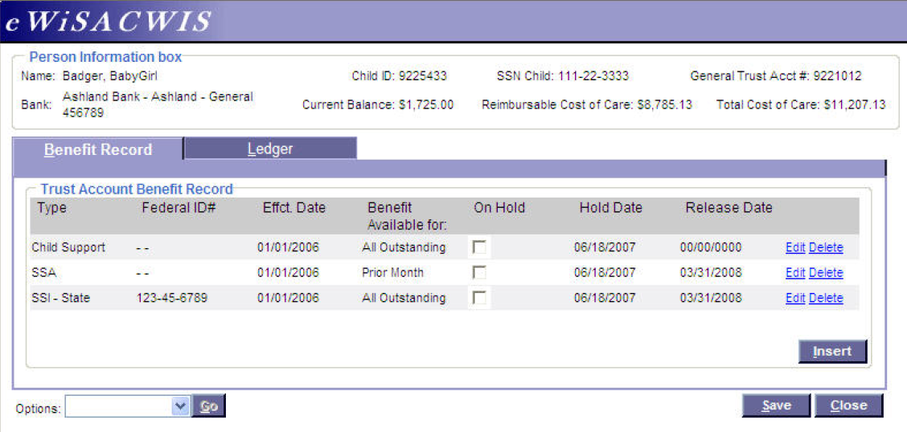
Benefit Record Tab
^{dcf.wisconsin.gov}
Notes:
The Benefit Record tab provides a summary look of the Benefit types, the Social Security Number, the date the benefit became effective for the child, how the benefit is to be used, the hold status of a benefit, and the corresponding date the benefit was either placed on hold or released. Clicking on the Edit hyperlink will take you into the Maintain Benefit Record page for the corresponding benefit type.

Slide 8
Inserting a Benefit Record
Click ‘Insert’ to add a benefit record
Notes:
To insert a new benefit type into the Benefit Record, click on the Insert button. This will open the Maintain Benefit Record page.

Slide 9
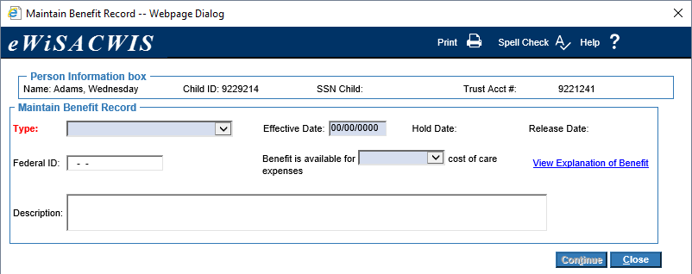
Maintain Benefit Record
Notes:
The Maintain Benefit Record page is where all benefits are created and maintained. With the exception of the Child Support benefit type, all other benefits must be created using the Maintain Benefit Record pop-up page. Child Support is automatically inserted with the creation of the Trust Account record when a child enters into a claimable/qualifying placement.

Slide 10
Benefit Record Types
Type of payments the child receives:
Child support
Parental support
SSI – Federal
SSI – State
SSA
Railroad retirees
Relinquished adoption assistance
Other (CIP, AODA, etc.)
Veterans benefits
Interest
^{dcf.wisconsin.gov}
Notes:
Benefit Record
Shows what types of payments receiving for child
The reason this is important is because different benefit types have different rules
For example, if the child is receiving child support, we can apply the child support to any expenses incurred at any point the child was in care
SSA is a lot more locked down – it can only be applied to the previous month’s cost of care

Slide 11
Child Support
Set up automatically in eWiSACWIS
KIDS referral questions on the placement determine if a referral is sent to KIDS (child support)
Ledger is automatically updated
Counties are not able to edit the amounts
^{dcf.wisconsin.gov}
Notes:
Child support is automated
On placement, KIDS Referral questions – depending how answered, referral sent over to KIDS/Child Support. When child support payments are received, we get those payments, and we will update the ledger in the trust account automatically. It’s DCF money, so it’s very easy for us to interface with another DCF system (KIDS).
Not able to be edited since we know the amount is correct
Benefits are payments made by a parent through a court order and collected by KIDS and dispersed to the appropriate County providing care for the child.
Benefits shall reimburse all outstanding cost of care (Food, Clothing and Housing) for that child beginning with current month costs.

Slide 12
All Other Benefit Record Types
Set up manually in eWiSACWIS
Deposits are entered manually
NOTE:
If the county doesn’t get money from any source, they don’t need to do anything with the trust account.
^{dcf.wisconsin.gov}
Notes:
It is important to note that a ledger entry cannot be made on a specific benefit until that benefit has been documented on the Benefit Record tab.
NOTE: if the notes on the benefit record contain special characters, can cause you to not be able to edit that record/type.

Slide 13
Benefit Rules
Each type of benefit carries with it special rules surrounding how that benefit may be used.
^{dcf.wisconsin.gov}
Notes:
‘Benefit is available for’ drop down is system derived based on the Type of benefit chosen. For example, when a user chooses Type of SSA, the system automatically selects “Prior Month” as the value in the ‘Benefit is available for’ drop down. This ultimately tells the system that any SSA money that comes in to offset the child’s cost of care shall reimburse a child’s prior month’s cost for care based on the month it was received. It also stipulates that any remaining funds that exceeded the cost of care shall remain in the trust account to be used for personal needs.
Default based on federal or state requirements for the benefit type. When a new benefit is set in eWiSACWIS, the system defaults the “Benefit is available for…” field to a specific value.
Enabled to allow the user to change the value if the situation arises, but in most circumstances, this should be left alone.
Prior Month:
Railroad Retirees
SSA
VA
All Outstanding:
All other benefit types

Slide 14
Effective Date
Two purposes:
Documents when that benefit became available for the county to use against their outstanding cost of care
Used by eWiSACWIS as the earliest date that refunds of that type can be used against the cost of care
^{dcf.wisconsin.gov}
Notes:
The Effective Date serves two purposes. It’s a book-keeping date that documents when that benefit became available for the county to use against their outstanding cost of care. It also is used by eWiSACWIS as the earliest date that refunds of that type can be used against cost of care.
Let’s take a look at a simple example on the next slide.

Slide 15
Effective Date Example: A child in your county’s care was in placement from January 1 - March 31. You received a lump sum check from SSI for $9,000 on May 1st. The check covers the months of January – March.
Effective date: May 1, 2018
Effective date: January 1, 2018
Reimbursable cost of care:
$9,000
Refunds from January 2018:
$3,000
After MF3:
$9,000
Reimbursable cost of care
$9,000
Refunds from January 2018:
$3,000
After MF3:
$6,000
Notes:
Simple example to show impact of effective date.
If May 1st is entered as the effective date, won’t draw down, even though SSI applies to ‘All Outstanding’. eWiSACWIS will ignore these entries, as the Effective Date directs that this benefit did not become eligible to be used against cost of care until May 1st.
At $3,000/month, the trust account balance would be $0 after the 3 months if Jan 1 was entered as the effective date.
If May 1 is entered as the effective date, the balance would remain at $9,000.
(See ticket 572611 for example that could be used to illustrate using Analysis page to figure this out.)
Q: On Child 9811998 you stated to make sure his Benefit “Effective date” is correct. Is this date in eWiSACWIS the date the child started SSA or the date we created the Trust Account due to out of home placement? In CARES the effective date and start of SSA Disbursement is 8/2014. The child was in out of home placement at the start of his SSA 8/2014. eWiSACWIS has 4/3/2015. It looks like I have access to just change the date if need be, but I’m not sure what this affects. Can I just change it? Is this a policy question?
A: Changing the date on benefit type – Yes, they can go back and change the benefit type start date to be the later of either 1) the beginning of the placement episode or 2) the date they became eligible for the benefit type. In this situation it sounds like they were eligible for SSA before the placement episode began so they can backdate the benefit effective date to the beginning of the placement episode.
Q: I want to know about your take on placement documentation/ bringing down the balance on a TA. Apparently child’s placement has not been documented and costs of care are not in eWiSACWIS. Are you (policy?) OK with skipping the placement documentation and only documenting the manual withdrawal to document what the county used already in prior years?
A; Skipping placement documentation – If the placement was never documented in eWiSACWIS we never submitted that placement as part of our IV-E claim. IV-E requires that IV-E reimbursable expenses be covered with trust account funds before non-IV-E COC expenses. In translation, they should only do manual adjustments for COC expenses (placement or otherwise) not documented in eWiSACWIS if the COC in eWiSACWIS is zero. If COC in eWiSACWIS is paid in full they can apply trust account money to non-eWiSACWIS COC expenses and manually adjust from eWiSACWIS. We have a number of kids that this has happened on. If they have paid off all COC expenses (eWiSACWIS and non-eWiSACWIS) and the child has left care, the money must be returned.

Slide 16
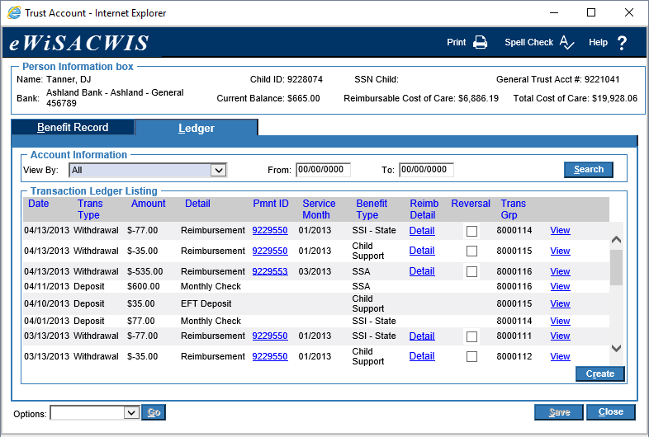
Ledger Tab
Click ‘Create’ to enter a transaction
Notes:
Provides a checkbook style listing of all deposits of benefits received and all withdrawals that have gone against the child-specific cost of care for the county
Before you can document a deposit or withdrawal on the ledger tab, you need to create and save the benefit record. You also need an assignment to the case in order to update the ledger.
A reimbursement row reflects a draw down of a benefit against cost of care.
Reimbursements will follow a first in, first out approach (FIFO)
Reimbursement Detail hyperlink will open the ‘Payment Reimbursement History’ page – to view draw downs that went against the current payment, the IV-E reimbursement history, and the days of care history.
A Reversal can only be done against a reimbursement. The reversal is a process that backs the reimbursement completely out of the Trust Account. For example, if SSA is incorrectly used to draw down against cost of care, then the Trust Account Manager can “reverse” this process. By checking the reversal checkbox of the appropriate reimbursement detail, the system will pull the reimbursement back from the payment it was drawn down against, and it will put those monies back into the trust account. You will be given the opportunity to tell the system whether the benefit's funds should remain in the trust account or if they should be withdrawn out so that future draw down batches will not occur against those monies.

Slide 17
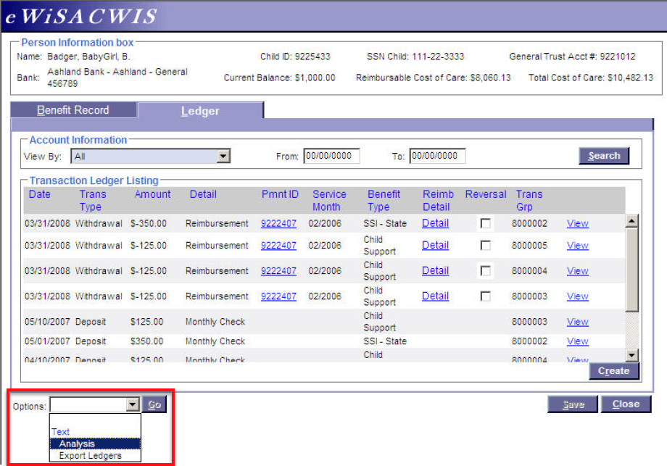
Options Dropdown
Notes:
The Options drop down contains two functional actions. One option will take you to an Analysis page. The second option will export the ledger detail to an Excel Spreadsheet.
The Analysis page offers Trust Account Managers a way to view their Trust Account data through two different avenues. You can view trust information from the perspective of the deposits that have come in for a child, or you can look at specific payment data and analyze the Drawdowns that have occurred against that payment.
The radio buttons in the Analysis Detail Criteria group box tell the system how you want to view your data. The From and To fields further let you narrow your search results based on the dates entered.
The second option (Export Ledgers) on the Ledger tab is to export the ledger detail to an Excel Spreadsheet. Once the export has finished, the results can be found in the eWiSACWIS folder. The results will come unformatted.

Slide 18
Reimbursable Cost of Care
vs.
Total Cost of Care
The Reimbursable Cost of Care only includes cost of care that is eligible for reimbursement.
The check the payment is associated with is in Outstanding status (i.e. check number entered).
The type of cost of care is a IV-E reimbursable cost.
The Total Cost of Care includes both reimbursable and non-reimbursable costs.
^{dcf.wisconsin.gov}
Notes:
Above the tabs, the Person Information box group box displays demographic information such as name, eWiSACWIS person ID, and Social Security Number. Along with this information, the group box also holds the Current Balance, Reimbursable Cost of Care, and Total Cost of Care. The difference between Reimbursable Cost of Care and Total Cost of Care is that the reimbursable cost of care only includes cost of care that is eligible for reimbursement. Meaning, the check the payment is associated with is in an Outstanding status (check numbers entered) and that the type of cost of care is a IV-E reimbursable cost. Kinship is not a reimbursable cost.
If there is a difference between Total Cost of Care and Reimbursable Cost of Care, then one must look to see if all check data has been entered correctly and/or is the type of cost of care a IV-E reimbursable type. The Person Information box group box also documents the bank that is being used to hold the benefits that come in for the children that have incurred cost of care in the county.

Slide 19
Monthly Financial 3 (MF3)
Trust account money is applied to the cost of care when MF3 runs each month
Is there money in the trust account?
Based on the rules for the type, can we apply it to cost of care for this month?
If yes, system will automatically post an adjustment (withdrawal) in the ledger to apply the amount that can be applied and adjust the cost of care accordingly.
^{dcf.wisconsin.gov}
Notes:
Usually between 10th – 15th of the month
Q: Made updates – should I wait until MF3 runs to see if the amounts update then?
A: The MF3 trust run will not automatically generate reversals for moneys that are recorded as collected but should not have been collected. You can manually check the reversal checkbox in the ledger for rows in which money was not actually collected.
Important note: For trust accounts, eWiSACWIS merely provides a ledger. It doesn’t actually move any money. If you need to return money you collected by mistake, then it is not enough to correct your ledger – you need to return the money in real life too. Determine whether you need to return money and to whom, and then adjust the ledger to accurately reflect what happened in real life.

Slide 20
Maintaining Non-eWiSACWIS Benefits
Benefits for children that were never in eWiSACWIS
In some instances, a child may have bridged the gap between having been in care before eWiSACWIS and having ended their out-of-home care after the county became fiscally live in eWiSACWIS
First document trust account benefits, then document non-eWiSACWIS benefits
^{dcf.wisconsin.gov}
Notes:
Non-WiSACWIS Benefits are benefits that are coming in for children that were never on eWiSACWIS. For example, if a county is receiving Child Support to offset cost of care for a child that had been in placement with the county 15 years ago, then those benefits will be documented through the Non-WiSACWIS Benefits page.
The most obvious road block to documenting these types of refunds in eWiSACWIS is that the children are most likely not known as persons to the system. Given this, the Non-WiSACWIS Benefits page was developed specifically to document benefits for these individuals. However, there is one caveat. In some instances, a child may have bridged the gap between having been in care before SACWIS and having ended their out-of-home care after the county became fiscally live on eWiSACWIS. In this instance, the county will need to document the benefits that have come in for that child two ways.
First, the county will need to document all benefits into the child’s eWiSACWIS Trust Account. Once all eWiSACWIS cost of care has been reimbursed, then the county will need to continue documenting benefits that have come in to offset the cost of care incurred prior to the county going fiscally live into the Non-WiSACWIS Benefits page.
Note: It is the responsibility of the county to calculate “life of case” costs for the child. In other words, the county is responsible for knowing when all of their costs (that were not a part of eWiSACWIS) have been fully recouped.

Slide 21
Maintaining Non-eWiSACWIS Benefits
^{dcf.wisconsin.gov}

Slide 22
Maintaining Non-eWiSACWIS Benefits
Date Created = prefills with today’s date when a new row is inserted and saved
Facility Type = select the type of facility where the child is/was in placement
Date App. To = enter the date of cost of care that the refund is going to offset. If unknown, choose the latest date known that the child was in placement.
WI Facility Name = enter the name of the facility where the child is/was in placement
WI Service Type = enter the service type for the placement
Refund Amt. = enter the amount of the refund
FFP Status = Federal Financial Participation. Select the appropriate status if known.
^{dcf.wisconsin.gov}
Notes:
Complete all required fields to the best of your knowledge.
Facility type:
Foster Home
Group Home
Kinship
RCC TFH
Unknown
FFP Status:
Eligible and Not Reimbursable
Eligible and Reimbursable
Not Eligible
Unknown

Slide 23
Trust Accounts FAQ
Why are reimbursements not offsetting cost of care?
The cost of care is not in Outstanding status
The benefit record is on hold
There is no cost of care for the time period specific to the benefit type
Effective date
Benefit rules
The cost of care is not reimbursable
^{dcf.wisconsin.gov}
Notes:
If reimbursements are not occurring against your cost of care there are a few possible reasons why:
1. The cost of care is not in an outstanding status (does not have check numbers attached). Remember only Outstanding cost of care will be touched by the reimbursement batches. Timing is critical. The Reimbursement batches run mid month, so if the check numbers are not entered in a timely manner then there may be delays in the reflection of the reimbursement.
2. The Benefit Record is “on hold.” Remember, when a benefit record is placed “on hold” the reimbursement batches will not touch it.
3. There is no cost of care for the time period specific to the benefit type. For example, the child goes into care January 3rd and the child receives a very quick turn around on SSA. The first check comes to the child January 25th. SSA can only be used for prior month costs of care (unless special permission is granted). There is no cost of care in this scenario for December and therefore, the SSA will remain in balance.
4. The cost of care is not reimbursable. Kinship cost of care for example is not factored into the trust account as it is TANF money and not IV-E eligible.

Slide 24
Trust Accounts FAQ
Can counties be reimbursed for part of the cost of care for a child that participates in the CLTS Medicaid Waiver Program?
Yes, the county can reimburse on the Basic and Supplemental potion of the rate. You may need to request a breakdown from the provider.
^{dcf.wisconsin.gov}

Slide 25
Trust Accounts FAQ
Why is child support not depositing into the trust account?
The most common reason is that there is a disconnect in the data between KIDS and eWiSACWIS, typically the child’s ID.
^{dcf.wisconsin.gov}
Notes:
There is a likely a disconnect in the data (specifically the child ID) between KIDS and eWiSACWIS. Verify with KIDS what person ID they have for the child represented in eWiSACWIS. It’s possible the interface isn’t occurring because KIDS can’t find the child due to an incorrect person ID.

Slide 26
Trust Accounts FAQ
A child is placed in an unpaid placement. The county is continuing to receive benefit payments (e.g. SSI, SSA, Child Support) and the trust account is now over the limit.
Because the placement is unpaid, eWiSACWIS does not apply the child’s benefits against the cost of care for this placement. If the county is paying for the placement outside of eWiSACWIS, manual withdrawals can be created in the trust account to reflect the payment.
^{dcf.wisconsin.gov}

Slide 27
Trust Accounts FAQ
Are counties allowed to put trust account money into an interest-bearing account?
Yes – eWiSACWIS has a function that spreads the interest earned amongst the active trust accounts. This process is done monthly.
Spread Interest function → Options dropdown on Bank Account page
^{dcf.wisconsin.gov}

Slide 28
Trust Accounts FAQ
Why did the limit for trust accounts decrease from
$2,000 → $1,500 → $1,000 over the years?
The amount was reduced over the years to limit the instances of a child going over the $2,000 mark and, therefore, becoming ineligible.
Must not exceed:
$2,000 to maintain Medicaid eligibility
$2,000 to maintain Social Security benefits
$10,000 to maintain Title IV-E eligibility
Note: This asset limit is for all persons in the AFDC group (usually family members residing in the household).
^{dcf.wisconsin.gov}
Notes:
SSI benefits are income-based. To continue receiving SSI, a beneficiary must not have resources worth more than $2,000. Once the trust account balance exceeds $2,000, the child is no longer eligible to receive benefits. The amount was reduced over the years to limit the instances of a child going over the $2,000 mark and, therefore, becoming ineligible.
Any SSI benefits received after the trust account exceeds the $2,000 limit will be considered an overpayment and will need to be repaid.

Slide 29
Trust Accounts FAQ
What types of things are acceptable spend downs for over-limit general trust accounts?
Examples as listed in the Social Security handbook - “A Guide for Representative Payees”:
Training for the beneficiary
Major health-related expenses
Other special training programs and school tuition
Special clothing needs
Home improvements
Furniture
Other items not a part of the child’s “current maintenance” to improve daily living conditions or provide better medical care
^{dcf.wisconsin.gov}

Slide 30
Trust Accounts FAQ
If the child is no longer in the county’s care and benefits continue coming in, or if benefits were incorrectly collected, how does the county go about returning the money?
Child support – make a connection with child support enforcement personnel at the county level. The county should inform the child support contact that the child is no longer in care or that child support money is incorrectly being funneled to the county. The child support contact should direct the county on the proper way to return the funds.
SSI/SSA – complete Termination of Representative Payee form and submit to Social Security Administration. Determine the amount of money that will need to be refunded – both Federal and State.
^{dcf.wisconsin.gov}
Notes:
‘On Hold’ feature for benefits continuing to come in even though child is no longer in case and cost of care balance is zero:
The purpose of this function is to allow Trust Account Managers to tell the draw down batches to ignore any refunds of a certain type.
One must remember that placing a benefit “On Hold” will stop draw downs from taking place against any refunds that have come in for that type. Therefore, if those refunds remain in the Trust Account (i.e. Are not withdrawn out), then the Trust Account, by virtue of not being able to draw down those refunds, will begin to accrue a balance. If that balance exceeds the Maximum Balance allotted ($1500.00), the Trust Account will be flagged as being Over the Limit.
No reimbursements will occur against a benefit record that is placed on hold. Placing a benefit on hold may be necessary if another department or agency supersedes the claiming of the benefit and the county wants to ensure that these monies are not being used to offset their cost of care.

Slide 31
Trust Accounts FAQ
Should counties continue collecting child support for arrears cost of care for closed cases?
If there are foster care or kinship care arrears due to the county foster care agency or the state, child support continues to collect those arrears until they receive an alert from foster care that the cost of care is paid or unreimbursed assistance balance is zero. If there are arrears, the child support case remains open as an arrears-only case. The current support would be moved to the original case with the court-ordered payee once the foster care or kinship care is closed.
^{dcf.wisconsin.gov}

Slide 32
Trust Account Reports
ADHOC023 – Trust Accounts
FM04A03 – Overpayments with Trust Accounts
FM0701b – Trust Account Current Balance Report
FM0702b – Trust Account Reconciliation Report
FM0703b – Ending Placements Report
FM0704b – Trust Account Deposit History Report
FM0705b – Trust Account Balance for Closed Cases
FM0706b – Trust Account Drawdown Report
FM0708a – Monthly KIDS Exception Report
FM0708b – Monthly KIDS Verification Report
https://dcf.wisconsin.gov/files/cwportal/ewisacwis/allreports.pdf
^{dcf.wisconsin.gov}
Notes:
List of reports that can be helpful when dealing with trust accounts.
Descriptions of reports can be found at the URL on the screen.
County security delegate can grant access to reports.

Slide 33
KIDS Exceptions
eWiSACWIS receives file from KIDS
Child support transaction created in the trust account if a match is found
If a match is not found, an exception is created.
^{dcf.wisconsin.gov}
Notes:
One common reason is a mismatch of IDs or names. You will likely need to touch base with KIDS (child support) staff to determine the reason and how to remedy.

Slide 34
Overpayments
How generated?
Manually by a financial user
Automatically by eWiSACWIS
Critical element in the county’s cost of care bottom line
Need to be monitored closely to ensure accurate IV-E claiming
Example:
Cost of care = $10,000
Overpayment = $1,000
If the overpayment isn’t documented, the State will incorrectly claim $10,000 for this child, rather than $9,000.
^{dcf.wisconsin.gov}
Notes:
When an overpayment occurs, it is immediately factored into the IV-E claiming calculation. This means that one should assess the status of the overpayment to determine if it is truly an overpayment. If there was an error in the creation of the overpayment, then the overpayment should be immediately cancelled since it is being incorrectly factored into the IV-E claiming calculation.
Reminder about how intertwined with trust accounts? If payment made with trust money, overpayment occurs, overpayment is repaid, may need to adjust the account once receive repayment.

Slide 35
Overpayments
^{dcf.wisconsin.gov}
Notes:
Outstanding = not yet repaid

Slide 36
Overpayments
Options:
Debit the full overpayment from the next check to the provider
Debit a partial amount from the next several checks to the provider
Settlement for a lesser amount
Send to collections
Write off
Cancel
^{dcf.wisconsin.gov}

Slide 37
Overpayments
^{dcf.wisconsin.gov}
Notes:
Provider Repayment Method is county-specific

Slide 38
Overpayments
^{dcf.wisconsin.gov}

Slide 39
In Process Checks
Once a check reaches ‘In Process’ status, there is an expectation that the check amounts are accurate for the purposes of IV-E claiming
Can’t be cancelled – must move to ‘Outstanding’ status to maintain
Need to apply check numbers and dates to the ‘In Process’ check to move it to ‘Outstanding’ status so it is available for IV-E claiming
‘In Process’ is an intermediate step in the process
Goal is to move the check to ‘Outstanding’ status in a timely manner
Interface vs. manual entry
^{dcf.wisconsin.gov}
Notes:
A check that remains In Process has not had a check number or check date applied to it. This check and its associated payments are not being included in our IV-E calculations. These monies will not be reimbursed when the Trust Account Draw Down batches run.
Manual:
Financial → Checks and Payments → Check Number Recording

Slide 40
Checks & Payments Maint. Question
Are agencies required to change the disposition for each check from “Outstanding” to “Cleared” once the check has cleared their bank?
No – there are several other dispositions a check can have, such as Cleared, Expired, or Redeposited, but these are optional. They are available to the county to use if they wish to be more descript regarding the status of a check, but there is no requirement that a county maintain the disposition of any check beyond Outstanding.
^{dcf.wisconsin.gov}

Slide 41
Reminder re: voucher numbers
Reminder to enter new voucher numbers in eWiSACWIS for the upcoming fiscal year that starts on July 1st
Required for the check write file to run successfully in July
How to:
Financial > Checks and Payments > Voucher Numbers
Select a year (you can set up years in advance)
Click Continue
Enter the ‘From’ and ‘To’ fields with the numbers set aside for the year. The current number field will automatically prefill.
Erin
^{dcf.wisconsin.gov}

Slide 42
Knowledge Web: Financial Page
^{dcf.wisconsin.gov}

Slide 43
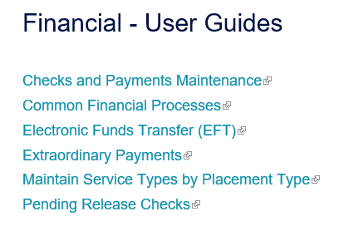
Knowledge Web: User Guides
Step by step instruction
Screen shots included
Guides updated/added
with each release
^{dcf.wisconsin.gov}

Slide 44
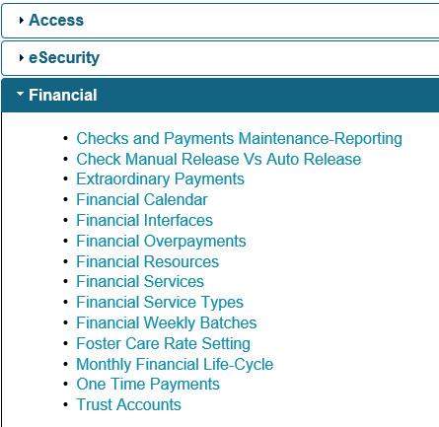
Knowledge Web: Videos
^{dcf.wisconsin.gov}

Slide 45
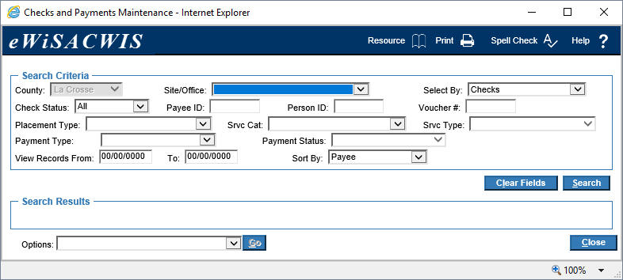
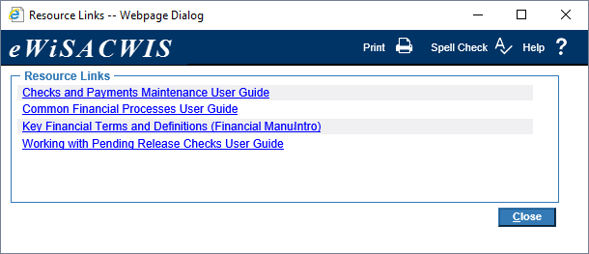
Resource Button
^{dcf.wisconsin.gov}

Slide 46
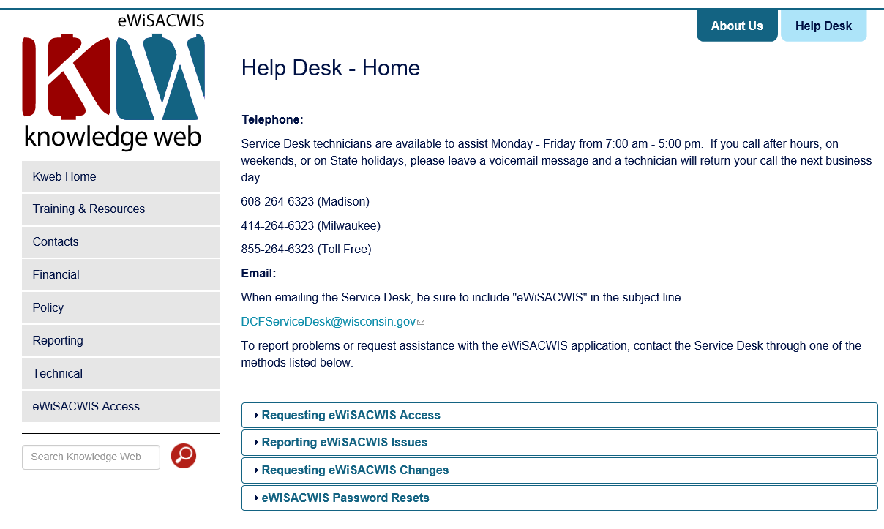
eWiSACWIS Help Desk
^{dcf.wisconsin.gov}

Slide 47
Contacts
Policy Questions
Dave Berndt, DCF Policy and Planning Analyst
(608) 422-6198, David.Berndt@wisconsin.gov
eWiSACWIS Questions
Help Desk
(855) 264-6323, DCFServiceDesk@wisconsin.gov
Erin Lorang, eWiSACWIS Business Analyst
(608) 422-6596, ErinA.Lorang@wisconsin.gov

Slide 48
Questions?

