Slide 1
What's new in eWiSACWIS

Slide 2
Staff Updates
New Section Chief – Jenny Bundrage
Vacancies
http://dcf.wisconsin.gov/wisacwis/knowledge_web/all-contacts/Program_Team_County_Map.pdf

Slide 3
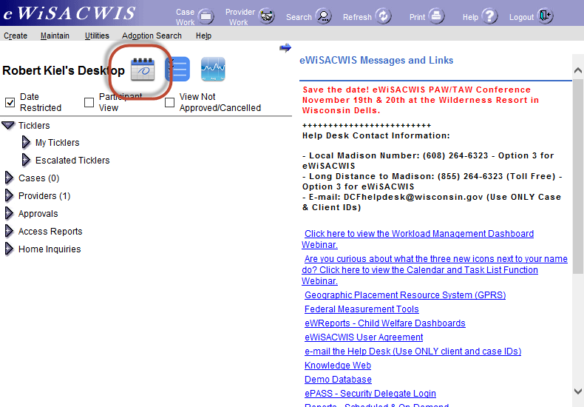
Calendar

Slide 4
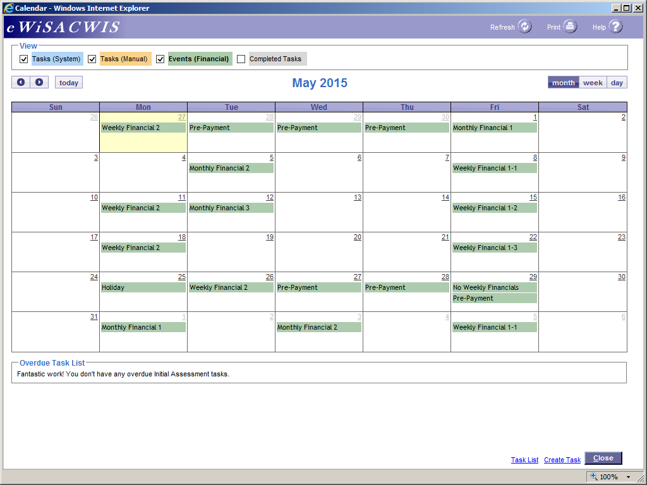

Slide 5
Coming June 12th
Supervised Independent Living Rates
Kinship past age 19
Change to payment generation batch
Fixes

Slide 6
Supervised Independent Living (SIL) Rates
Why?
Sets a child specific rate per the Supervised IL rate form and generates payments from Wisacwis.
Documents and tracks amounts by cost item.
Allows the state to claim Title IV-E funds.

Slide 7
SIL Rate
When setting an appropriate monthly SIL rate for a child, the county or Department may include the following cost categories:
Rent/Renter’s Insurance
Food Budget
Furnishings
Household Supplies
Utilities (Electricity, Heat, Water and Sewer)
Telephone
Clothing
School Supplies
Personal Incidentals
Daily Supervision (treated as an Admin payment for claiming)
Other (these costs will not be IV reimbursable)

Slide 8
SIL Rate
For supervised IL placements a new Supervised Independent Living Rate page will be used to document all cost items contained in a Supervised IL rate.
Accessed via Maintain -> Independent Living
One rate is created per SIL Placement.

Slide 9
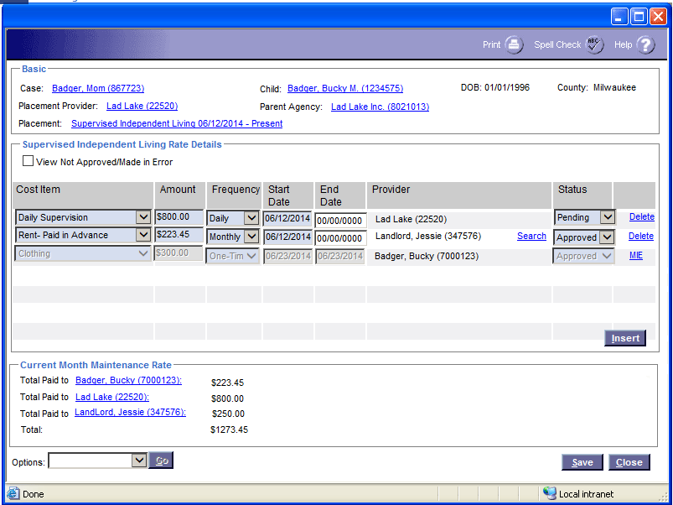

Slide 10
SIL Rate
Each cost item will automatically create a service on approval, which will generate payment.
Each cost item can be set to go to a different provider (for example: rent to landlord, food to youth, daily supervision to agency)
Each cost item can be set for a different time period and payment frequency (monthly, daily, one-time), up to 6 months in the future.

Slide 11
SIL Rate
The SIL Rate does not follow the normal eWiSACWIS approval process. An automated message will be utilized to notify the approver about these items once they are documented.
All of these cost items will be linked to the youth’s supervised independent living placement.

Slide 12
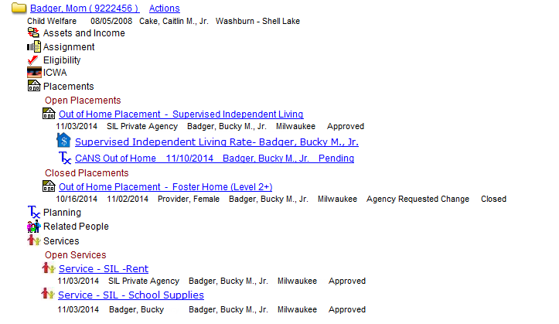

Slide 13
Messaging
In addition to being notified when items are ready to be approved fiscal workers will also be receive e-mails at the end of the month if there are SIL Placements without a rate or with pending items.
Similar to the missing foster care rate message that is sent monthly.

Slide 14
Kinship for over 19
Modifications to the placement, service, and one-time payment documentation process in eWiSACWIS to support the switch to a different set of kinship care service types when the youth turns 19.
Service types will be labeled “KC age 19 and older” or “KC under age 19”
Counties can then associate these service types with a different reporting category so that they can claim the related costs outside of Temporary Assistance for Needy Families (TANF) funds.

Slide 15
Messaging
A new e-mail message to inform of children in kinship who turn 19 and the placement needs to be ended.
Message is sent when:
Two months before the child’s 19th birthday (when the child is 18 years and 10 months old);
On the child’s 19th birthday;
On the last day of the month of the child’s 19th birthday.
Every month with pre-payment runs for children over 19
Counties will be notified if they have any exisitng kinship services for over 19.

Slide 16
Change to Payment Generation Batch
Instead of only processing closed placements that have been approved for ending in the last 75 days, the program will process closed placements/services that have been approved for ending on or after 12/01/2012.

Slide 17
Consequently…
The first regular run of the program (after we go live with the release) will generate the payments/overpayments that were missed for existing placements because of the 75-day condition.
Affected counties will be notified in advance.

Slide 18
Skip one day delay for moving checks from Release to In Process
Currently the batch ignores checks for which the disposition date is not at least one day old. That might be helpful for checks in Pending Status (to make sure workers get at least one day to review the pending check), but not when the status is Release.

Slide 19
Fixes
Ending a placement with end date that is the same as start date was causing the system to end the Foster Care Rate as Made in Error.
Approval of a foster care for a previous closed placement is ending the current open FC rate for the open placement.
Preventing a foster care rate that ends before it starts.

Slide 20
Things to keep in mind…

Slide 21
Check Number Recording
We have found counties are not consistently recording the check numbers and dates of checks in eWiSACWIS via the Checks Printed interface.
Without the check number and date information, the associated payments cannot be processed for Title IV-E claiming. Additionally, trust account money cannot be applied towards these payments.
This could mean lost revenue for the State/County.

Slide 22
Find In Process Checks
Please make sure that the Checks Printed interface files are still being uploaded to be processed.
To check use the Maintain Checks and Payments Maintenance page to search out the county’s checks with status of In Process.

Slide 23
Checks that have been issued but are still In Process
Prepare the missing Checks Printed interface files and upload them to the Outbox folder on VPN
Or use eWiSACWIS online Check Number Recording page to add the missing check numbers and dates.

Slide 24
Past checks that were not issued in part or in full
Use the Check Number Recording page to enter a bogus check number and date (to update the check status to Outstanding).
If the check was not issued at all, cancel the outstanding check using the disposition of ‘Cancel- Do Not Pay’.
If a check was issued for some of the payments on the eWiSACWIS check, the county can Cancel- Reschedule the outstanding check. Then include the payments that were paid out on a manual check, and cancel the payments that were not paid out.

Slide 25
Dealing with overpayments
Counties are not consistently canceling overpayments that are not real overpayments.
For example, an overpayment that was generated as a result of making the placement in error for purpose of recreating the placement, but the original payments were accurate.
The overpayments should be canceled, they cause a reduction in the federal claim.

Slide 26
Resources
Financial Interface reference materials: http://dcf.wisconsin.gov/wisacwis/knowledge_web/technical/interfaces/County_interface.htm#Intf
Here’s another link to dealing with In Process checks:
http://dcf.wisconsin.gov/wisacwis/knowledge_web/financial/financial-manual/In%20Process%20Checks.pdf
And one for dealing with overpayments:
http://dcf.wisconsin.gov/wisacwis/knowledge_web/financial/financial-manual/Overpayments.pdf
And this might be helpful too for correcting past data:
http://dcf.wisconsin.gov/wisacwis/knowledge_web/financial/financial-manual/Common-Financial-Processes.pdf

Slide 27
Questions?

