Slide 1
Purchase of Services Contract Guide
Julie Anstett and
Lucinda Champion
Friday, May 6, 2016
Wisconsin Department of Health Services
Notes:
Welcome to the Purchase of Services Contract Guide Presentation.

Slide 2
What is the Purchase of Services Contract Guide?
Wis. Stat. §46.036 requires counties to use contracts under certain circumstances and specifies requirements for the business relationship between Purchaser/Grantors and Provider/Grantees. This document is a guide for meeting the requirements of the statute.

Slide 3
What is the Purchase of Services Contract Guide?
Contains sections of a contract that should be considered when purchasing services.
Not all sections are required
Always consult with legal counsel when developing a contract.
Contracts for Purchases/Grants less than $10,000 in a calendar year may be waived by the Department.

Slide 4
Contract Summary
First Page of the Sample Contract Template
Sections
Purchaser/Grantor and Provider/Grantee Information
Purchaser/Grantor and Provider/Grantee Signatures
Contract Information and Source of Funding
Summary of Contract Provisions

Slide 5
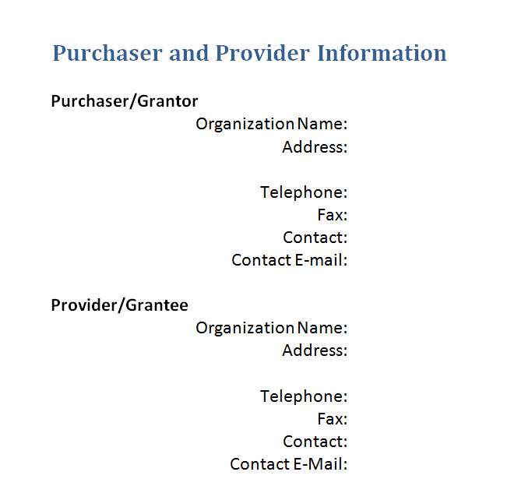
Purchaser/Grantor and Provider/Grantee Information

Slide 6
Summary of Contract Provisions
High Level overview of the Contract and Services
Organizing Aid
Table of Contents
List of Exhibits or Items Attached to Contract

Slide 7
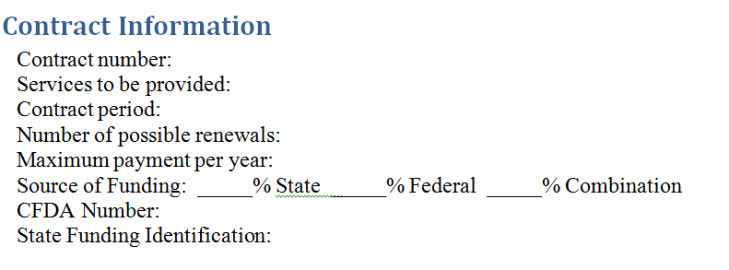
Contract Information and Funding Source

Slide 8
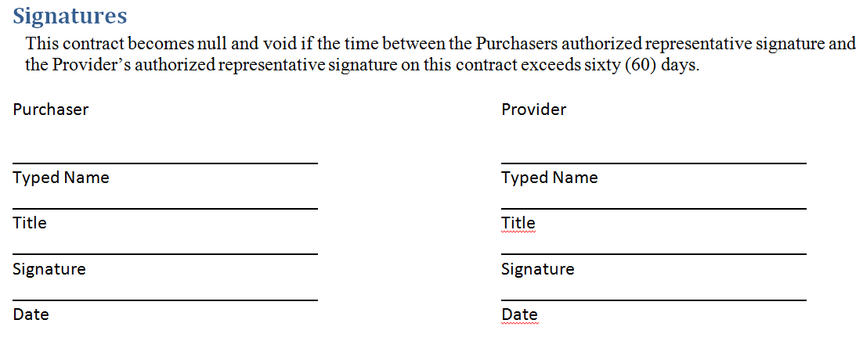
Purchaser/Grantor and Provider/Grantee Signatures

Slide 9
Audit
Wis. Stat. §46.036 requires a Provider/Grantee to have an audit when granted $25,000 or more.
Federal Uniform Guidance requires an audit when expenditures are $750,000 or more of total federal funds.

Slide 10
Caregiver Background Checks
Wisconsin Act 27 included provisions requiring background and criminal history checks of personnel who are responsible for care, safety and security of children and adults.

Slide 11
Civil Rights Compliance and Affirmative Action
Civil Rights and Affirmative Action Plans are required per Federal and State laws. The complete Civil Rights Compliance (CRC) and Affirmative Action (AA) Plans are available online.

Slide 12
Client Funds
Dependent on program requirements
Two options
Purchaser/Grantor provided services
Provider/Grantee provided services
Purchaser can decide who will handle the funds.

Slide 13
Clients Rights and Grievances
The Wisconsin Statutes §51.61 and Administrative Code DHS 94, Patient Rights, define rights and grievance procedures for clients.
This section ensures that compliance is met for the clients.

Slide 14
Conditions of the Parties’ Obligations
Items that may be included in this section are but not limited to:
Warranty
Breach of Contract
Damages
Enforceability
Timing/schedule

Slide 15
Confidentiality
This section ensures that the Provider/Grantee agrees to protect the identity and privacy of clients.
Avoid disclosing any information that could cause potential harm to third parties.

Slide 16
Conflict of Interest
Provider/Grantee agrees to enforce risk measures to avoid circumstances that professional judgment or actions regarding a primary interest will be unduly influenced by a secondary interest.

Slide 17
Debarment and Suspension
The Federal Grants Management Common Rule located in HHS Codification – 45CFR92.35, prohibits making sub-awards to debarred and suspended parties.

Slide 18
Eligibility
State or Federal eligibility is mandated by program area.
Identify who is responsible Provider/Grantee or Purchaser/Grantor.

Slide 19
HIPPA - Health Insurance Portability and Accountability
To be used when the Provider/Grantee is using protected health information to provide relevant administrative services.

Slide 20
Indemnity and Insurance
Corporation Counsel, Risk Managers and Insurer can determine the types and levels of coverage that should be required.

Slide 21
Independent Contractor
The Provider/Grantee is not controlled by the Purchaser/Grantor.
The Provider/Grantee is not to be considered an employee, agent or volunteer.

Slide 22
License, Certification and Staffing
State or Federally mandated by program.
Licensing and certifications required should be identified.
Information on how to acquire and maintain.

Slide 23
Liquidated Damages
Compensation to the Purchaser/Grantor for losses incurred if the Provider/Grantee doesn’t fulfill the terms of the contract.
Corporation Counsel can determine the types and levels required.

Slide 24
Matching, Level of Effort and Earmarking
Programs may have matching, level of effort or earmarking requirements.
Include specified requirements in this section.

Slide 25
Payments and Allowable Costs
The Purchaser/Grantor should have policies and procedures to determine reasonable rates and allowances.

Slide 26
Records
Maintenance of records supporting the financial and performance of the services performed.
Retain records for entire required period.

Slide 27
Reporting
This Section should contain specific guidelines per program requirements and methods of filing reports.

Slide 28
Revision or Termination of Contract
This section should contain information about any revisions or termination of the contract.
Examples:
Failure to submit an audit
Lack of performance or the quality of performance
Ineligible to receive Federal funds
Funding was reduced or eliminated for the program

Slide 29
Services to be provided
Define the Scope of Work (SOW) to be performed and the expectations

Slide 30
Special Provisions for High Risk Contract
Determine if contract is high risk.
If it is determined to be high risk, outline the requirements and conditions or restrictions in this section.

Slide 31
Sample Scenario
Take 5 minutes and read the sample purchase of service scenario.
Identify the Section the statement refers to.
Identify whether or not the section applies to a contract.
Determine the type of agreement to be used.

