Slide 1


DCF Rate Regulation of Child Welfare Providers
May 4th, 2017
Kevin Pings
kevin.pings@wisconsin.gov
608-422-6387

Slide 2

Goals for Today
Introduction
Rate Setting Timeline
Process and roles
Types of costs and formulas
Review of Cost Report
Calculation of Maximum Ceiling Rates
Questions/Discussion
^{dcf.wisconsin.gov}

Slide 3

Rate Regulation Background
Started rate regulation in 2011
  State Statute Sec. 49.34
  Wisconsin Admin Code Ch. DCF 52, 54 & 57
Prior to Rate Regulation providers proposed own rates
  Costs not controlled
Created disadvantages to purchasers
  Purchasing power
  Supply & Demand
Overall goal : To determine the cost of each agency for providing care for one child for one day.
  Not total cost recovery, or paying for open beds
  Providers operating more at capacity recover higher % of costs
^{dcf.wisconsin.gov}

Slide 4
Who do we regulate??
Three Provider types
  Child Placing Agencies –CPA - (admin rate only)
  Group Homes - GH
  Residential Care Centers - RCC
Providers that take funding from Wisconsin Public Purchasers
Licensed providers can file for rate regulation exemption
^{dcf.wisconsin.gov}

Slide 5
What’s Important??
Accuracy
Transparency
Opportunity and fairness
Responsible steward of tax payer dollars
Balance between DCF, purchasers and providers
  Supporting providers to care for kids
  Ensuring purchasers have reasonable options for care
^{dcf.wisconsin.gov}

Slide 6
Size of Provider Network
Reported data in 2016
  RCC – 30 providers with 204,522 placement days
  GH – 71 providers with 124,475 placement days
  CPA – 24 providers with 268,519 placement days
$145M+ in total reported costs
  From <$200k year up to $15M
^{dcf.wisconsin.gov}

Slide 7
Rate Setting Timeline
General annual timeline for rate setting
Jan 1 Individual provider rates take effect in eWisacwis
Jan-March Update Cost Report template for new year, provide training, etc
March-May Issue updated Cost Report to be used by providers
Jun-Aug Receive Cost Reports from providers, populate Master Database
Aug Present prelim ceiling rates
Sept 1 Post final ceilings rates
Sept-Nov Receive rate requests and set individual provider rates
Nov 1 Inform providers of upcoming year’s rate
Nov-Dec Conduct requested negotiations and mediations
Dec 31 Post individual provider rates
^{dcf.wisconsin.gov}

Slide 8

What Tools Do We Use?
Cost Report
  Excel Workbook, filled out by providers
  Input fields for cost line items
  Calculates individual rate starting point
  Provides structure and stability
Master Database
  Excel Workbook, populated with cost reports
  ‘All provider’ Cost Report
  Calculates Ceiling Rates
  Compiles COLA
  Tabulates staffing ratios
  Handling of ‘Outliers’
^{dcf.wisconsin.gov}

Slide 9
Preparing for the Upcoming Year
‘The Offseason’
January - April
DCF ‘resets’ the annual Cost and Service Report
  Updating new IRS tax rates and cutoffs
  Inputs prior year Max Rate info and COLA figures
  Implements any fixes or updates that are identified
DCF meets with Rate Regulation Advisory Committee as well as with the associated Fiscal Subcommittee and a Formula subgroup
  Look at prior data sets
  Investigate discrepancies
  Explore concerns or opportunities to make the cost report and overall process more accurate and transparent.
^{dcf.wisconsin.gov}

Slide 10
Preparing for the Upcoming Year
‘The Offseason’
January - April
Rate Regulation Advisory Committee – RRAC
  Formed by statute rule, meets quarterly
  Consists of DCF, WAFCA (Wisconsin Association of Family & Children Agencies), selected providers, county reps & purchasers
  Reviews rate setting process updates
  Forum for discussion of concerns and ideas
  Breaks out to sub committees
    Fiscal
    Performance Based Measures
    Formula Subgroup
^{dcf.wisconsin.gov}

Slide 11
Starting the Process
‘The Preseason’
May – June
The Cost and Service Report is obtained and filled out by individual providers using their audited financial statements
  DCF works with providers helping fill out their Cost Report
  Questions from where to submit to allowable costs to what line do certain expenses belong on
Cost reports along with financial audits start flowing into DCF starting in June, with EOB July 1 being the deadline for on time submissions.
  Each day late is a $25 forfeiture penalty per cost report and per audit per day.
^{dcf.wisconsin.gov}

Slide 12

Starting the Process
‘Regular Season Kickoff’
July - August
By this time all providers’ Cost Reports should have been received by DCF, and starts through the review process
  Program Area (basic info completeness)
  Licensing (licensed beds, provider type)
  Audit (compares to audit, ensures financial completeness)
  Accounting (begins closer checks and max rate builds)
^{dcf.wisconsin.gov}

Slide 13
Starting the Process
‘Regular Season Kickoff’
July - August
Program Area
  Owns the front end completeness
  Verifies timeliness
  Looks at personnel reasonability
  Resource for closer questions of cost alignment
  Completes notes for final review
^{dcf.wisconsin.gov}

Slide 14
Starting the Process
‘Regular Season’
July - August
Licensing
  Reviews current license issues
  Verify reported licensed beds
  Completes notes for final review
^{dcf.wisconsin.gov}

Slide 15

Starting the Process
‘Regular Season’
July - August
Audit Section
  Receives audited financials & compares to cost report
  Total $’s, matching line items, situations from notes
  Verifies allowable profit figures, takes action if needed
  Completes notes for final review
^{dcf.wisconsin.gov}

Slide 16
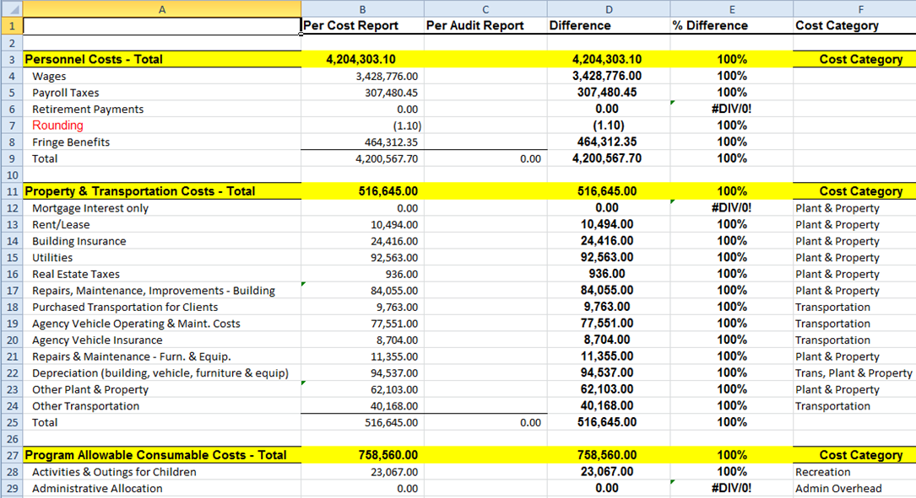
Audit Review
DCF Audit group compares the Cost report values to the providers’ annual audit report submitted annually to verify accuracy.
^{dcf.wisconsin.gov}

Slide 17
Other DCF Audit Activities
Desk Reviews – each provider annually
Gets approvals for profit collection
In-depth financial reviews
  Selected providers each year
  On-site visits
  Obtains more detail, down to receipts
  Resolves accounting issues that are found
  Try to review all providers within a few years
^{dcf.wisconsin.gov}

Slide 18
Continuing the Process
‘Regular Season’
July - August
Accounting
  Ongoing questions internally and externally
  Review notes from other areas
  Updates any reasonability issues
  Enters the cost report into the Master Database
^{dcf.wisconsin.gov}

Slide 19
Maximum Ceiling Rate Determination
‘Regular season’
July - August
Use notes of concern from audit, make any reasonability updates and imports each Cost Report into the ‘Master Database’
  Roughly 140 Provider Programs are entered
  Database groups by provider type and other data points
  Calculates the maximum ceiling rates, by cost category, by provider type
These rates are reviewed by the Rate Regulation Advisory Committee, as well as presented for approval within DCF up to the Secretary
Maximum Rates are posted online and in provider memos including the individual rate request form for providers
^{dcf.wisconsin.gov}

Slide 20

Maximum Ceiling Rate Determination
‘Regular season’
What’s the purpose of the Maximum Rates?
Part of Statute and Rate Regulation Rule
Baseline maximum for expected care
Set using DCF standards of measurement
Helps control ‘outlier’ provider costs
Can be looked at as a whole, or each cost component
^{dcf.wisconsin.gov}

Slide 21
Individual Rate Setting Process Starts ‘End of the regular season’
September - October
Given the published Maximum Rates, providers submit their individual rate requests to DCF
  Typically a lot of discussion with providers
  Discuss how their original submission was viewed
  Chance to voice concerns over additional facts
DCF then starts setting each individual rate given several factors
^{dcf.wisconsin.gov}

Slide 22
Individual Rate Setting Process Starts ‘End of the regular season’
The Factors by Administrative Rule:
Whether the proposed rate exceeds the maximum rate determined by the department
The provider’s most recent cost and service report
The provider’s most recent audit report
Whether the provider’s reported costs are within a range of similar costs reported by other providers for similar items and services
The provider’s per client rate in previous years
Changes in the consumer price index for all urban consumers, U.S. city average, as determined by the U.S. department of labor, for the 12 months ending on June 30 of the year in which the proposed rate is submitted
Changes in the allowable costs of providers based on current actual cost data or documented projections of costs
Changes in program utilization that affect the per client rate
Changes in the department's expectations relating to service delivery
Changes in service delivery proposed by a provider and agreed to by the department
The loss of any source of revenue that had been used to pay expenses, resulting in a lower per client rate for services
Whether the provider is accredited by a national accrediting body that has developed child welfare standards
Changes in any state or federal laws, rules, or regulations that result in any change in the cost of providing services, including any changes in the minimum wage
Competitive factors
The availability of funding to pay for the services to be provided under the proposed rate
^{dcf.wisconsin.gov}

Slide 23
Individual Rate Setting Process
‘Playoffs’
Exceptions to the Maximum Rate
Providers can request an above-the-max rate
Must meet certain criteria in proposal
  Specialized service
  Specific population
  Benefits of program
  What extra costs are needed
DCF Panel reviews packets to approve/deny exception
Rate built upon cost categories needed to support population
^{dcf.wisconsin.gov}

Slide 24
Individual Rate Setting Process
‘Playoffs’
November - December
By November 1, all providers must have been issued a posted rate by DCF
If provider agrees with the rate, the process ends
If provider disagrees with the rate
  Negotiation – Discussion with provider to review rate
  Mediation – DCF meets with provider and independent mediator
  Appeal – Both parties appear before Administrative Law Judge
Final Rates are eventually posted by Jan 1 (pending late appeals)
^{dcf.wisconsin.gov}

Slide 25

Mediation and Appeal Process
Confrontation is Good!
Process outlined in statute
Ensures everyone is heard
Last year nearly 50 providers entered negotiation process
  Mostly informative
Resulted in 28 requests for mediation
Two providers went to scheduled mediations
Zero appeals
  Last appeal was in 2014
^{dcf.wisconsin.gov}

Slide 26
Back to the Beginning
‘Offseason’
January and on
Finish all open mediations/appeals
Complete and review with RRAC and internal DCF
Legislative Audit Bureau
  Sample audit of individual rates and rationale for setting
Some info and benchmarks shared to agencies
^{dcf.wisconsin.gov}

Slide 27

Building a Rate
Fixed – Costs incurred regardless of daily placements such as rent, property taxes, security systems.
  Costs are allocated by # of licensed capacity beds
Variable – Costs driven by occupancy numbers such as food & beverage, activities, allowances.
  Costs are allocated by the # of average daily placements
Semi – Fixed costs with variable components such as utilities, janitorial expenses, repairs and maintenance.
  Costs are allocated by using an average of # of licensed capacity beds and # of average daily placements
^{dcf.wisconsin.gov}

Slide 28
Comparison of Cost Types
60 Licensed Capacity Beds
40 Average Daily Placements
50 Average of Licensed Capacity Beds and Average Daily Placements
Fixed –Costs are allocated by # of licensed capacity beds
$50,000/365 days/ 60 licensed capacity beds= $2.28 per diem
Variable –Costs are allocated by the # of average daily placements
$50,000/365 days/40 average daily placements = $3.42 per diem
Semi –Costs are allocated by using an average of # of licensed capacity beds and # of average daily placements
$50,000/365 days/50 average of LCB and ADP=$2.74 per diem

Slide 29
Types of Personnel Costs
Fixed – Costs incurred regardless of daily placements such as accountants, maintenance workers, etc.
  Costs are allocated by the # of licensed capacity beds
Variable (Direct Care & Supervision) – Costs driven by occupancy numbers such as case managers and intake workers.
  Costs distributed by staffing ratios
Semi – Fixed costs with variable components such as medical staff and teachers.
  Costs are allocated by the # of reported staffed beds
^{dcf.wisconsin.gov}

Slide 30
Direct Care & Supervision Rates
Typically highest turnover positions with most open time
  Can make accurate annual $’s fluctuate
  Variance across board for what level it’s staffed at
Rather than total $/single denominator with other costs
  Given average placements and staffing ratio, calculates amount of FTE’s needed to cover all shifts each day and multiplies that by the average position salary by provider
Normalizes the spend with staffing expectations, ie: 1 to 3 vs 1:1.

Slide 31
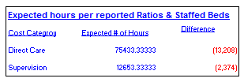
Direct Care and Supervisory Calcs
Calculated differently due to varying levels of care and often open positions
  Uses average placements, staffing levels and average salary
  This ‘hidden’ check to see if reported direct care/supervision hours make sense
  If variance is outside of acceptable range, DCF follows up with the provider to determine what issues need to be adjusted
  Rate setting uses a DCF averaged staffing ratio
    Verified with reported ratios to ensure accuracy
^{dcf.wisconsin.gov}

Slide 32
Extraordinary Payments
Rates are based upon ‘average’ costs
But not all placements are the same
One off situations
  Purchaser agrees with provider
  Child/placement specific
These are outside of rate setting
  Some purchasers verify with DCF about what’s already included
^{dcf.wisconsin.gov}

Slide 33
Review Cost Report Example
Examples of a Cost Report from 2017 Rate Setting process
  Random data added
Directions
  Includes instruction manual, definitions, examples
  Online webinars available
^{dcf.wisconsin.gov}

Slide 34

Cost Report Controls
Tip of the iceberg
  What providers see is limited
  Blocks off areas
Locked Down
  Prevents accidental altering of formulas
  Possible abuse of the cost report
Various calculations to verify reasonability
  Lots of data points that add up individually
^{dcf.wisconsin.gov}

Slide 35
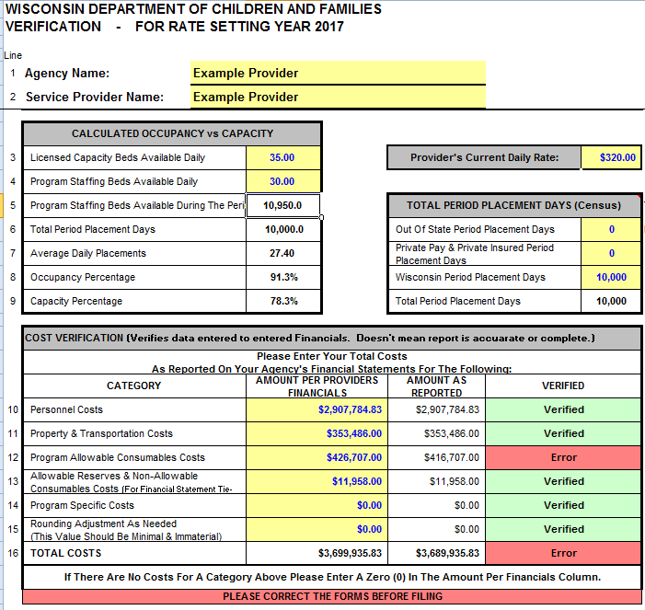
Cost Report Verification
Collects staffing and capacity information
Serves as a checkpoint for total reported costs vs audited totals
^{dcf.wisconsin.gov}

Slide 36
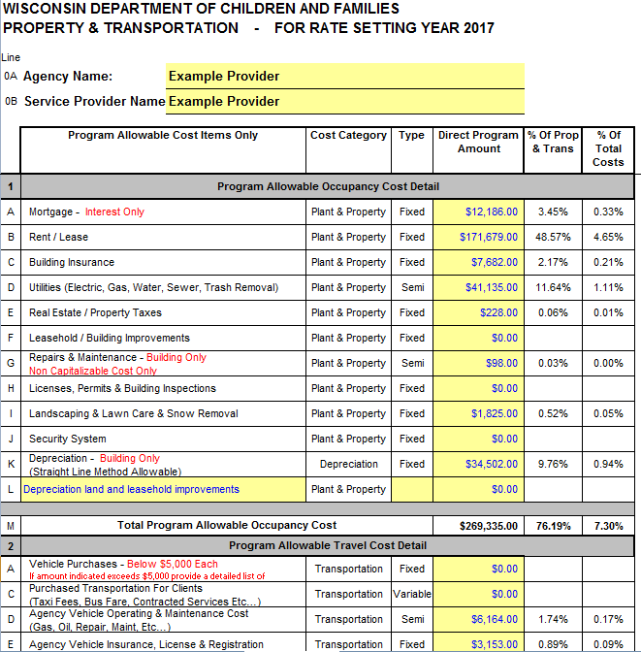
Property & Transportation
Costs of opening the doors
Mostly fixed costs, property, transportation, furniture, etc.
12% of total reported costs for 2017
Typical issues
  Related party
  Expense/Depreciable
^{dcf.wisconsin.gov}

Slide 37
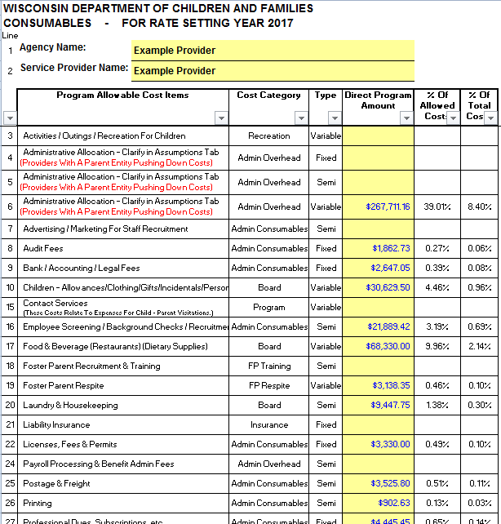
Consumable Costs
Daily costs to serve population
More variable, semi costs
23% of total costs for 2017
Typical issues
  Allocations
  Service Spending
^{dcf.wisconsin.gov}

Slide 38
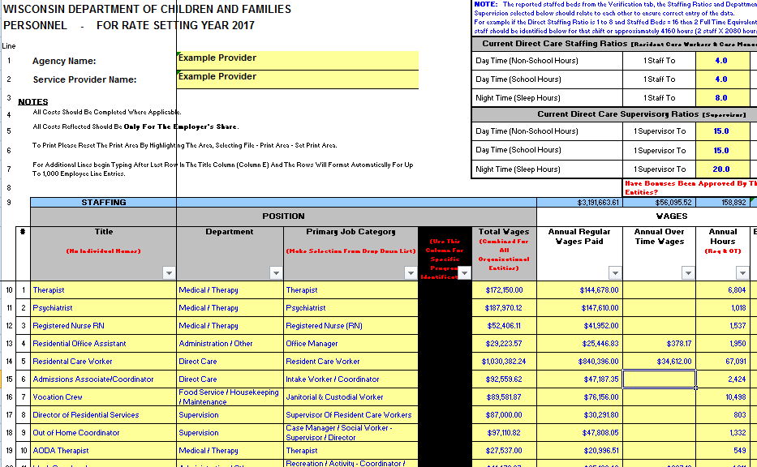
Personnel Costs
Includes staffing ratios, job titles, departments, hours and costs
65% of total costs for 2017
Typical issues – Staffing ratios, job categories
^{dcf.wisconsin.gov}

Slide 39
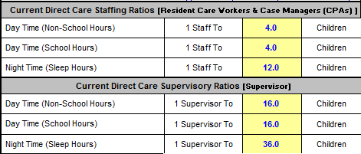
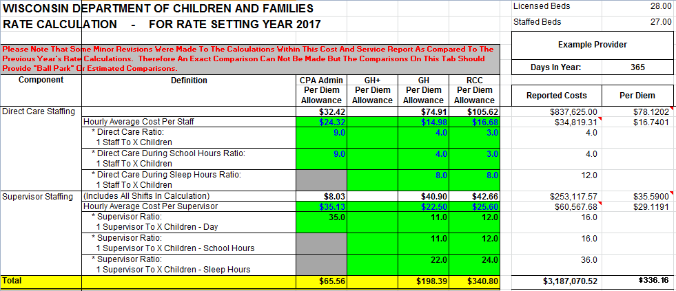
Impact of Staffing Ratio Changes
DCF monitors ratios and baselines the results for rate setting
^{dcf.wisconsin.gov}

Slide 40
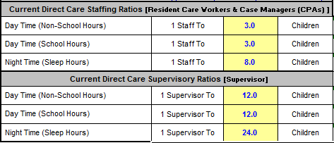
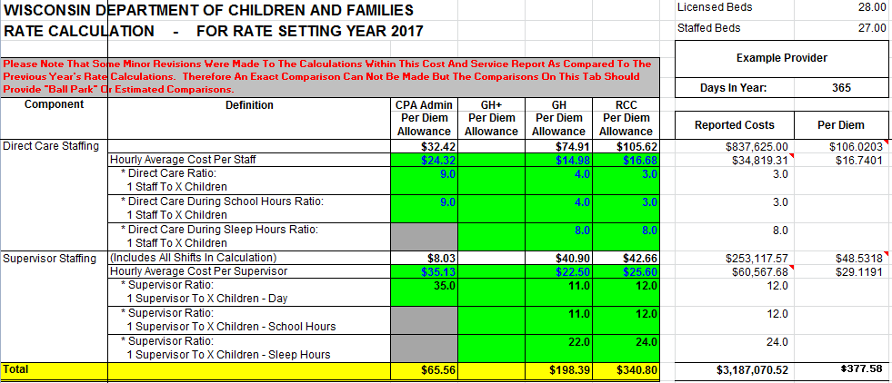
Impact of Staffing Ratio Changes
A small change has large impact. $41.42 or 12% increase
^{dcf.wisconsin.gov}

Slide 41
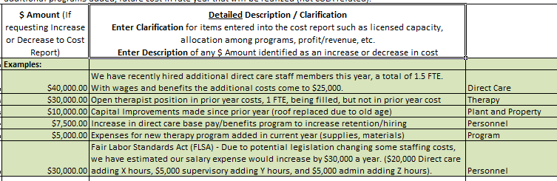
Future Cost Assumptions
Rate setting for 2017 based off of 2015 audited financials
New positions, current costs not reflected in audited financials
Each item reviewed for reasonability, approved/denied, added to cost report
^{dcf.wisconsin.gov}

Slide 42
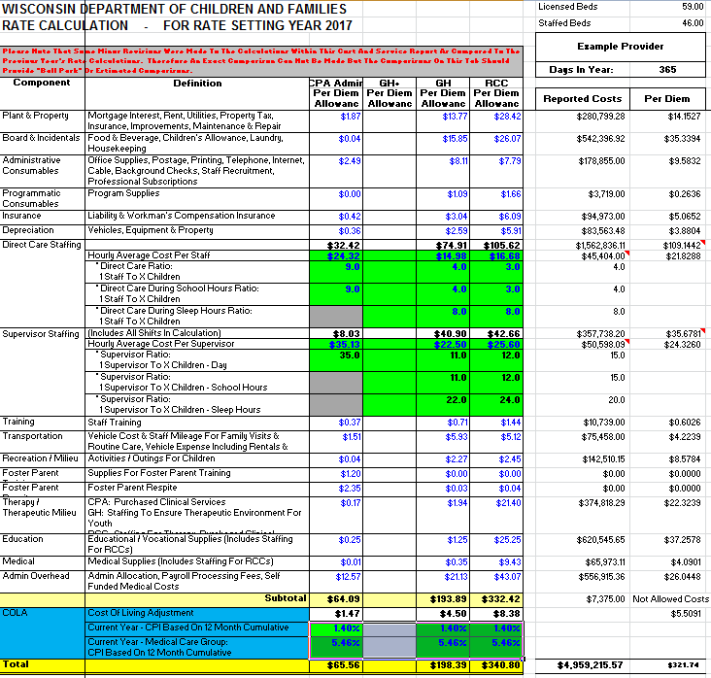
Rate Calculation
Summary tab by cost category
Contains PY max rates for reference
Starting point for setting individual rates
^{dcf.wisconsin.gov}

Slide 43
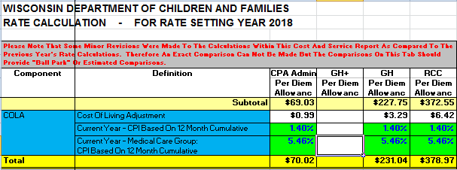
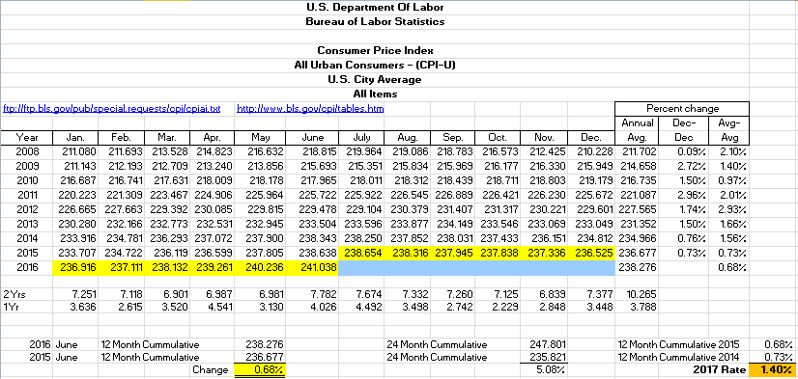
COLA Adjustment
Prior year data to calculate next year’s rate
Bureau Labor Statistics
Calculated for ‘All goods’ as well as for ‘medical costs’
2 year rolling average
Applied on the rate calc tab
^{dcf.wisconsin.gov}

Slide 44
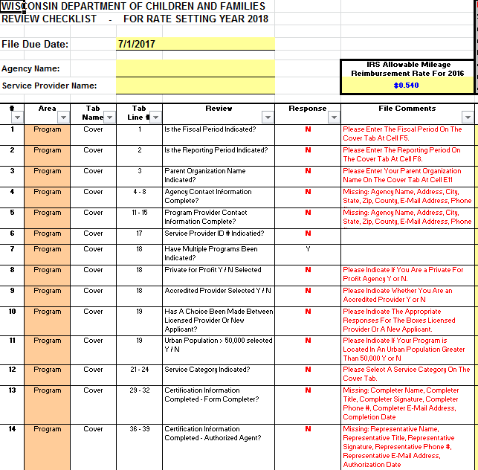
Review Checklist
Progress checklist
Sorted by area, indicates any ‘missing’ data
Allows for quick check of completeness
^{dcf.wisconsin.gov}

Slide 45
Going Forward, Example of Change
Last cycle updated the way ceiling rates calculated
  Major concern about retaining direct care staff
  $15/hr standard applied to max rate calc only
  If allowable profit unreported, manually included
  Concerned over FLSA and other unreported costs
  Better wages hope for better care and shorter stays
  Individual rates still based on actual costs
^{dcf.wisconsin.gov}

Slide 46
Year to Year Approved Figures
2017 Figures
2016 Figures
# of Agencies & Requested Above/Below Max Rate
 | Total | Ceiling | Above | Below
CPA | 23 | 65% | 0% | 35%
GH | 75 | 59% | 1% | 40%
RCC | 27 | 26% | 26% | 48%
Total | 125 | 53% | 6% | 41%
Final DCF Approved Rate Set at
 | Total | Ceiling | Above | Below
CPA | 23 | 30% | 0% | 70%
GH | 75 | 1% | 1% | 97%
RCC | 27 | 4% | 22% | 74%
Total | 125 | 7% | 6% | 87%
# of Agencies & Requested Above/Below Max Rate
 | Total | Ceiling | Above | Below
CPA | 24 | 58% | 4% | 38%
GH | 81 | 70% | 4% | 26%
RCC | 30 | 43% | 27% | 30%
Total | 135 | 62% | 9% | 29%
Final DCF Approved Rate Set at
 | Total | Ceiling | Above | Below
CPA | 24 | 38% | 0% | 63%
GH | 81 | 43% | 2% | 54%
RCC | 30 | 37% | 27% | 37%
Total | 135 | 41% | 7% | 52%
^{dcf.wisconsin.gov}

Slide 47

Looking Ahead
Continue further analysis of rate data and potential options
  Capture data from different calculation methods
    Other ideas as well as other states’ approaches
  Review of individual cost buckets
    Determine if different approaches are warranted
  Regular meetings, discussions, and brainstorming
    Process becoming stable, but are we doing everything the best way?
^{dcf.wisconsin.gov}

Slide 48
In Closing
Goals are to be accurate, transparent and fair
DCF has many checks in place, including review of financial audits
Process heavily structured, yet open for reasonability and review
Encourage input, feedback and discussion from all angles during the process

Slide 49

Questions?
^{dcf.wisconsin.gov}

